Slide 1
Methods and Theories for Large-scale Structured Prediction
EMNLP Tutorial 2016
Xu SUN
Peking University
xusun@pku.edu.cn
Yansong FENG
Peking University
fengyansong@pku.edu.cn

Slide 2
Content And Lecturer
Models & Regularization
Conventional Model
Structures & Applications
Latent Model
Neural Model
Sequence Structure
Tree/Graph Structure
Xu SUN
Yansong FENG

Slide 3
Content And Lecturer
Models & Regularization
Conventional Model
Structures & Applications
Latent Model
Neural Model
Sequence Structure
Tree/Graph Structure
Xu SUN
Yansong FENG

Slide 4
Models and Regularization for Large-scale Structured Prediction
Xu SUN
Peking University
xusun@pku.edu.cn

Slide 5
Outline
Introduction
Model
Conventional Model
Latent Model
Neural Model
Regularization
How-tos

Slide 6
Outline
Introduction
Model
Conventional Model
Latent Model
Neural Model
Regularization
How-tos

Slide 7
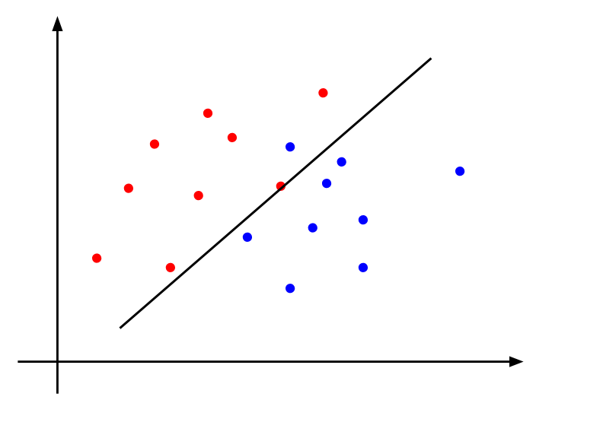
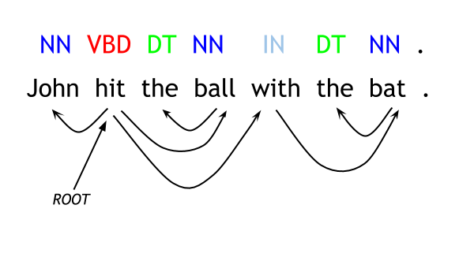
What Is Structured Prediction/Classification?
Types of Classification
Binary Classification
Multiclass Classification
Structured Classification

Slide 8
Why Structured Prediction?
Structures are important in natural language processing
Linguists also attempt to understand the rules regarding language structures
Phonetics
Semantics
Pragmatics
Morphology
Syntax
and many more
R Wardhaugh. Introduction to Linguistics.

Slide 9
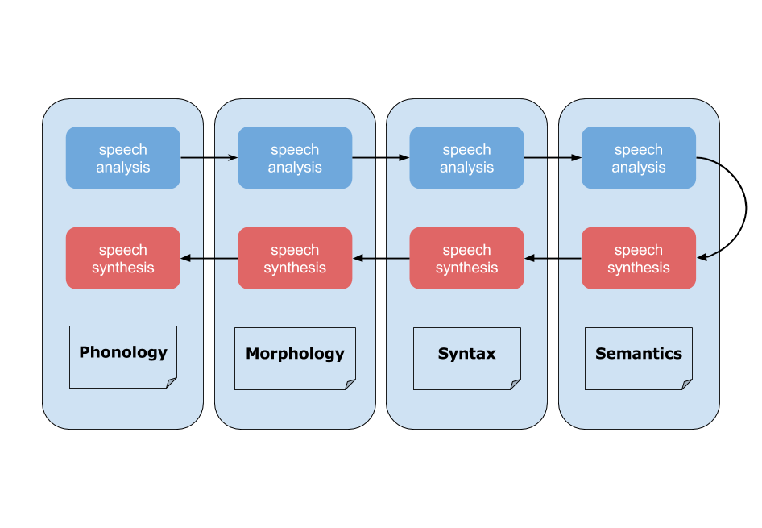
Why Structured Prediction?
Challenges in NLP involve Understanding and Generation
Understanding the structures in natural languages is an essential step towards the goal
M Bates. Models of natural language understanding.
D Jurafsky and JH Martin. Speech and language processing.
CD Manning and H Schütze. Foundations of Statistical Natural Language Processing.

Slide 10
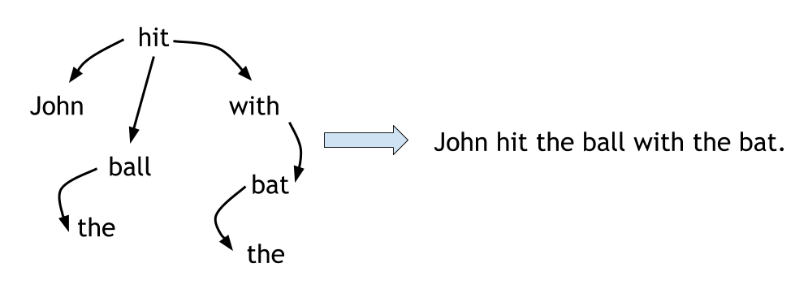
Why Structured Prediction?
However, most of the time, structure prediction is not straight-forward
Why it is hard? --Natural languages encode all of the structures in a linear form
N Chomsky. Language and mind.
N Chomsky. Reflections on language.
MAK Halliday. Language structure and language function.
N Chomsky. Knowledge of language: Its nature, origin, and use.
D Biber, S Conrad, R Reppen. Corpus linguistics: Investigating language structure and use.

Slide 11
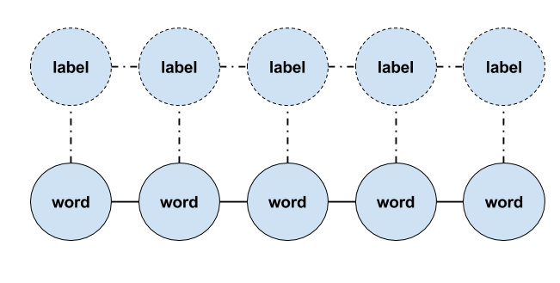
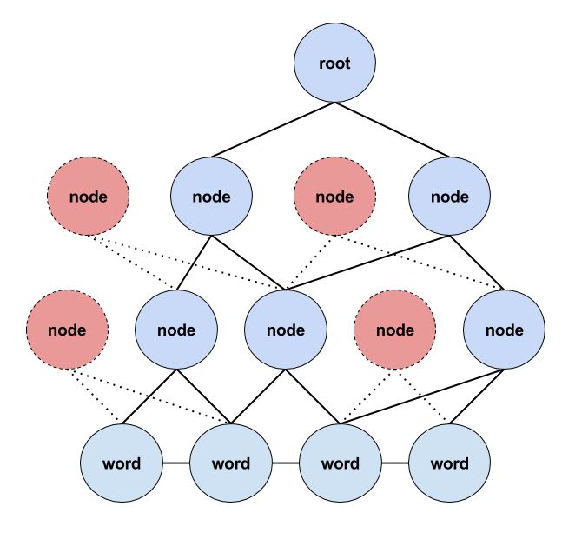
Why Structured Prediction?
Structured prediction helps to recover the structures in natural languages
POS Tagging (Collins, ACL 2002; Gimenez & Marquez, LREC 2004.; Shen et al., ACL 2007; Søegaard, ACL-HLT 2011; Sun, NIPS 2014; Collobert et al., JMLR 2011; Huang et al., 2015)
Chunking (Kudo & Matsumoto, NAACL 2001; Collins, ACL 2002; McDonald et al., HLT-EMNLP 2005; Sun et al., COLING 2008; Collobert et al, JMLR 2011; Huang et al., 2015 )
NER (Florian et al., HLT-NAACL 2003; Chieu, CoNLL 2003; Ando & Zhang, JMLR 2005; Collobert et al., JMLR 2011; Passos et al., CoNLL 2014; Huang et al., 2015)
Parsing (Earley, 1970; Collins, EACL 1997; Klein & Manning, ACL 2003; Sha & Pereira, HLT-NAACL 2003; Nivre, IWPT 2003; Collins, ACL 2004; Nivre & Scholz, COLING 2004; McDonald, HLT-EMNLP 2005; Zhang & Clark, EMNLP 2008; Zhang & Nivre, ACL-HLT 2011;Socher, et at., EMNLP 2013; Chen & Manning, EMNLP 2014)
Word Segmentation, Summarization, Machine Translation...

Slide 12
Outline
Introduction
Model
Conventional Model
Latent Model
Neural Model
Regularization
How-tos

Slide 13
Outline
Conventional Model
Latent Model
Neural Model
Conditional Random Field
Latent Dynamic CRF
Latent Variable Perceptron
Recurrent Neural Network
LSTM-CRF
Long Short-term Memory
Structure Perceptron
MIRA
Probabilistic Perceptron
Reduce Annotation Engineering
Reduce
Feature Engineering
Latent Model
Conventional Model
Neural Model

Slide 14
Conditional Random Fields (CRFs)
Proposed by Lafferty et al. (2001)
Maximize a conditional probability
$p\left(y | x,θ\right)=\frac{1}{z(x,θ)}exp⁡\left(\sum_{k}{θ_{k}f_{k}(y,x)}\right)$
$Z\left(x,θ\right)=\sum_{y′}{exp⁡\left(\sum_{k}{θ_{k}f_{k}(y′,x)}\right)}$
Global model
Predict global structure, not local classifier
Training: globally normalized objective
Decode: Viterbi algorithm
y₁
y₂
y₃
y₄
y_{n}
x₁
x₂
x₃
x₄
x_{n}

Slide 15
Conditional Random Fields (CRFs)
Proposed by Lafferty et al. (2001)
Maximize a conditional probability
$p\left(y | x,θ\right)=\frac{1}{z(x,θ)}exp⁡\left(\sum_{k}{θ_{k}f_{k}(y,x)}\right)$
$Z\left(x,θ\right)=\sum_{y′}{exp⁡\left(\sum_{k}{θ_{k}f_{k}(y′,x)}\right)}$
Global model
Predict global structure, not local classifier
Training: globally normalized objective
Decode: Viterbi algorithm
But the training speed is quite slow…

Slide 16
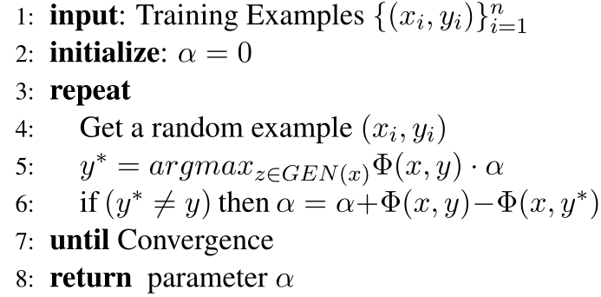
Structured Perceptron
Proposed by Collins (2002)
Simple and fast
No gradient computation
Update only on error
Viterbi decode
Theoretical guarantee
Converge if data is separable
M
K
L
G
H
I
J
A
B
C
D
E
F

Slide 17
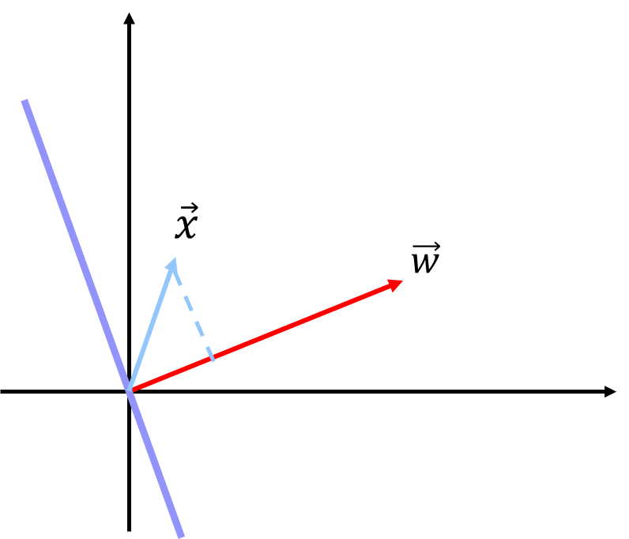
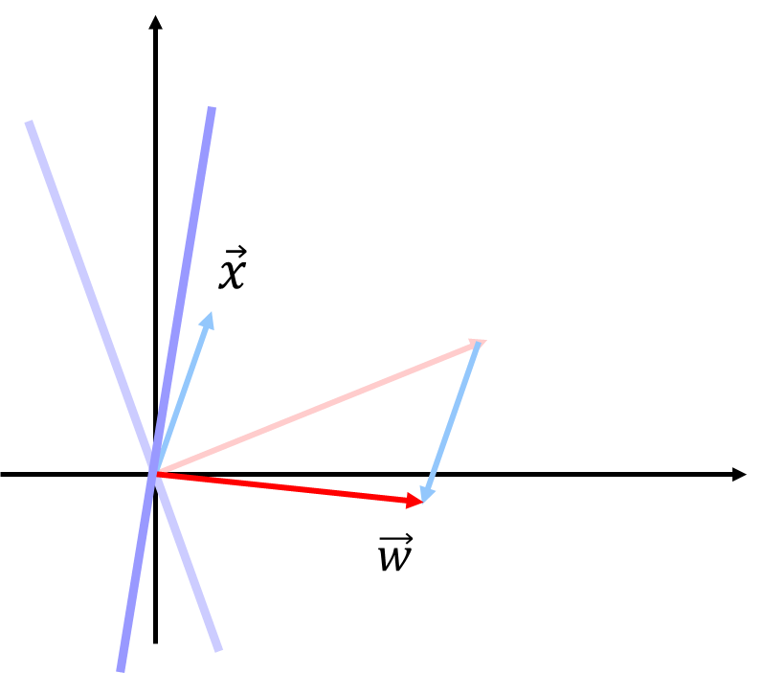
Structured Perceptron
Proposed by Collins (2002)
Simple and fast
No gradient computation
Update only on error
Viterbi decode
Theoretical guarantee
Converge if data is separable

Slide 18
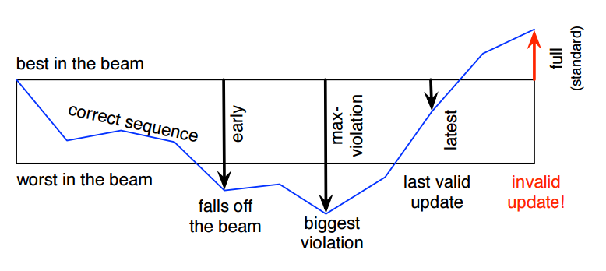
Structured Perceptron
Inexact search
Greedy search
Beam search
Parameter update
Early update (Collins & Roark, ACL 2004)
Margin Infused Relaxed Algorithm (MIRA) ( Crammer et al. 2006)
Max-violation (Huang et al., NAACL 2012)
Figure from Huang et al. (2012)

Slide 19
For Large-scale Structured Prediction
Current structured prediction methods are not ideal
A trade-off between accuracy and speed…
low performance high
CRFs
k-best MIRA
MIRA
Structured Perceptron
fast speed slow

Slide 20
For Large-scale Structured Prediction
A solution works well in practice for large-scale structured prediction problems
Introducing probabilistic information into perceptrons
This goes to Probabilistic Perceptron (SAPO) (Sun 2015)
X. Sun. Towards shockingly easy structured classification: A search-based probabilistic online learning framework. 2015

Slide 21
Probabilistic Perceptron (SAPO)
Proposed by Sun (2015)
Same (or even higher) accuracy like CRF
Fast training speed like perceptron
0.53
root John hit the ball with the bat
Probabilistic Perceptron Update
0.25
root John hit the ball with the bat
root John hit the ball with the bat
training sample
……
0.03
root John hit the ball with the bat
X. Sun. Towards shockingly easy structured classification: A search-based probabilistic online learning framework. 2015

Slide 22
Probabilistic Perceptron (SAPO)
Proposed by Sun (2015)
Structured Perceptron Update
root John hit the ball with the bat
root John hit the ball with the bat
training sample
1-best sample
0.53
root John hit the ball with the bat
Probabilistic Perceptron Update
0.25
root John hit the ball with the bat
root John hit the ball with the bat
training sample
……
0.03
root John hit the ball with the bat
n-best samples with probability

Slide 23
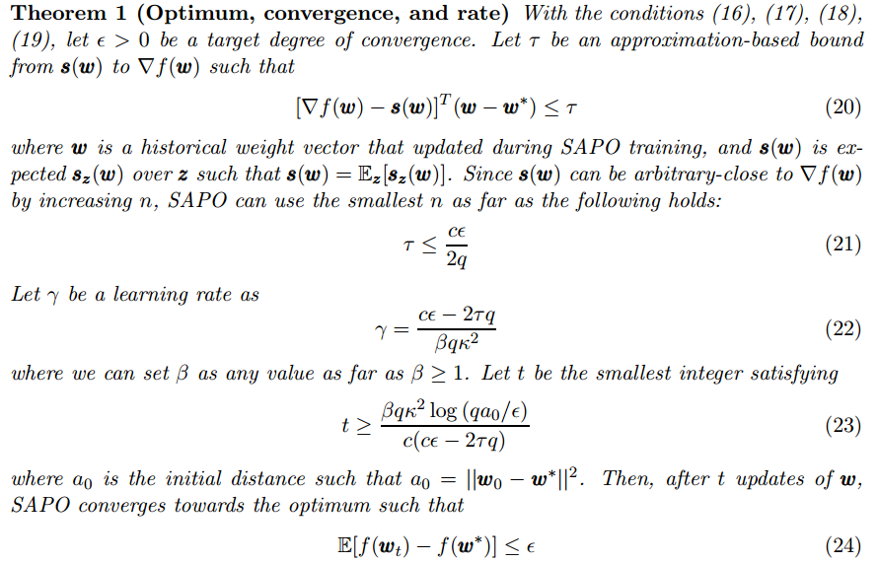
Probabilistic Perceptron (SAPO)
Theoretical guarantee of convergence
Probabilistic perceptron converges!

Slide 24
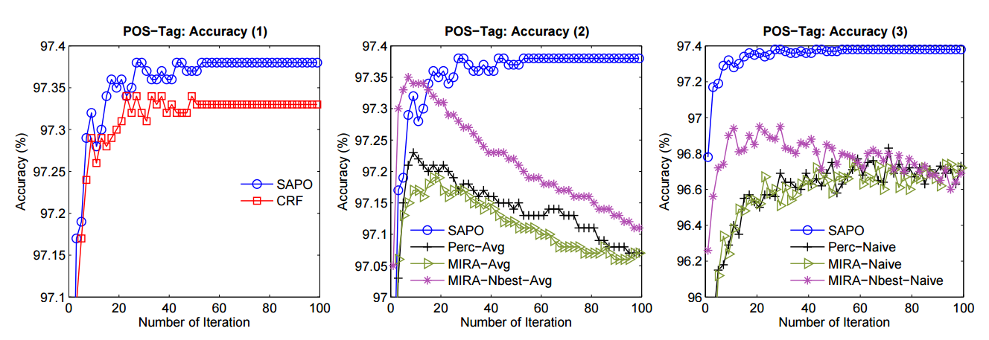
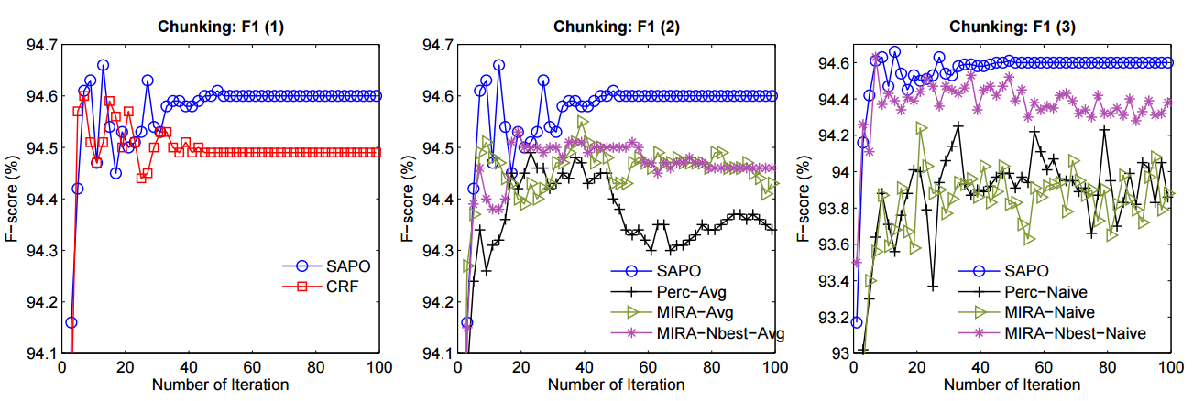
Probabilistic Perceptron (SAPO)
It indicates the number of samples is not the larger the better, why?
Experiment results
Similar or even higher accuracy compared with CRFs, perceptron and MIRA

Slide 25
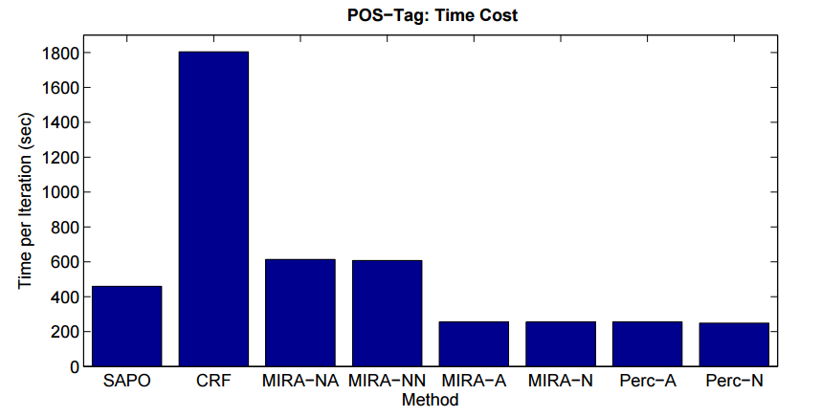
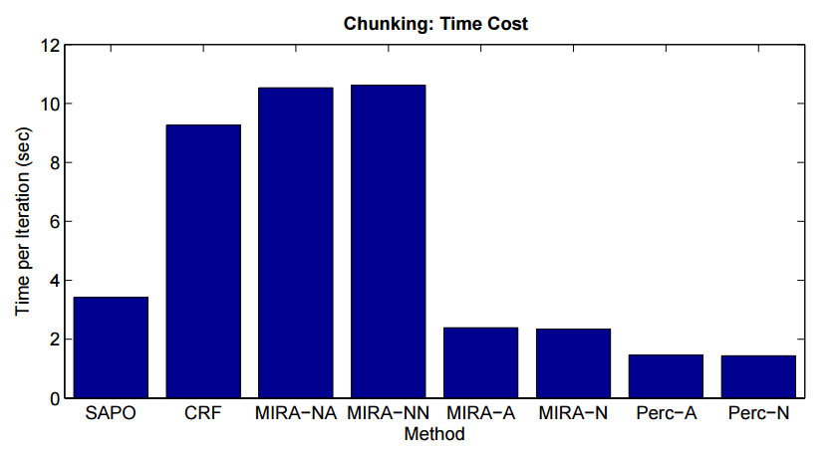
Probabilistic Perceptron (SAPO)
Experiment results
Much faster than CRFs
Nearly as fast as perceptrons

Slide 26
Probabilistic Perceptron (SAPO)
Experiment result
No rising complexity of weights compared to MIRA or Perc.

Slide 27
For Large-scale Structured Prediction
Probabilistic Perceptron Sun (2015)
SAPO
CRFs
bad performance good
k-best MIRA
MIRA
Structured Perceptron
slow speed fast

Slide 28
Outline
Typical methods need large-scale annotations
Problem in reality
Lack of annotations
Inaccurate annotations
Latent Model
Reduce Annotation Engineering

Slide 29
Outline
Conventional Model
Latent Model
Neural Model
Conditional Random Field
MIRA
Latent Dynamic CRF
Latent Variable Perceptron
Recurrent Neural Network
LSTM-CRF
Probabilistic Perceptron
Structure Perceptron
Long Short-term Memory
Reduce Annotation Engineering
Reduce
Feature Engineering
Latent Model
Conventional Model
Neural Model

Slide 30
Motivation
Latent-structures (hidden info) are important in natural language processing (Matsuzaki et al., ACL 2005; Petrov & Klein, NIPS 2008)
Parsing: Learn refined grammars with latent info
S
NP
VP
.
PRP
VBD
NP
.
He
heard
DT
NN
the
voice
Notes:
pro

Slide 31
Motivation
Latent-structures (hidden info) are important in natural language processing (Matsuzaki et al., ACL 2005; Petrov & Klein, NIPS 2008)
Parsing: Learn refined grammars with latent info
S-x
NP-x
VP-x
.-x
PRP-x
VBD-x
NP-x
.
He
heard
DT-x
NN-x
the
voice

Slide 32
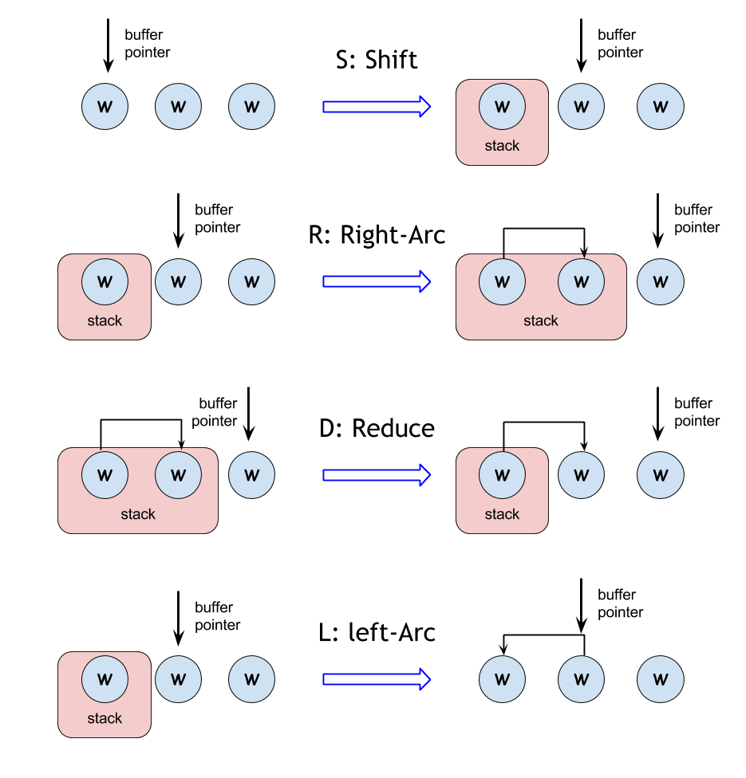
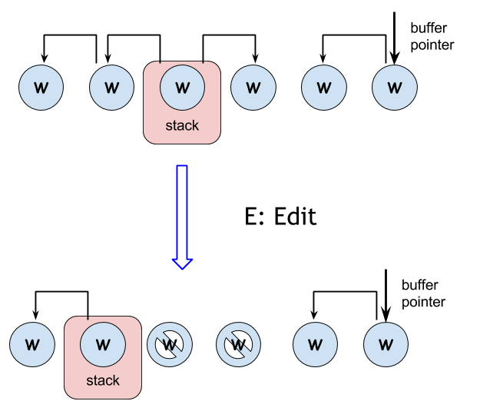
Motivation
Latent-structures (hidden info) are important in dependency parsing (Honnibal & Johnson, TACL 2014)
A transition system (arc-eager) extended with an EDIT transition

Slide 33
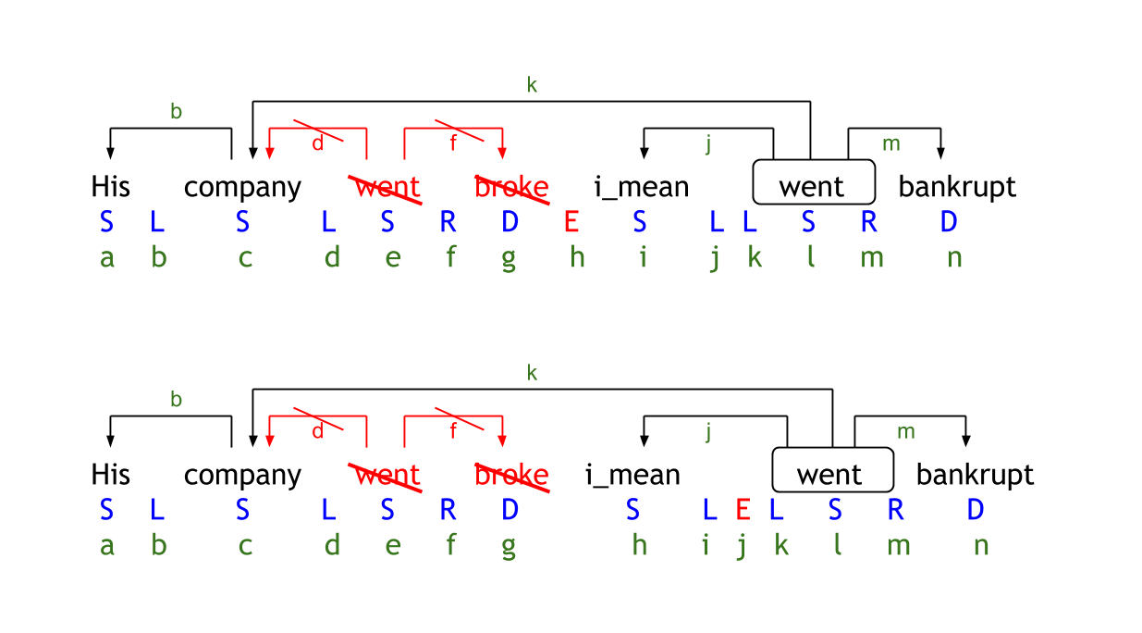
Motivation
Latent-structures (hidden info) are important in dependency parsing (Honnibal & Johnson, TACL 2014)
Different transition sequences to the same gold-standard tree

Slide 34
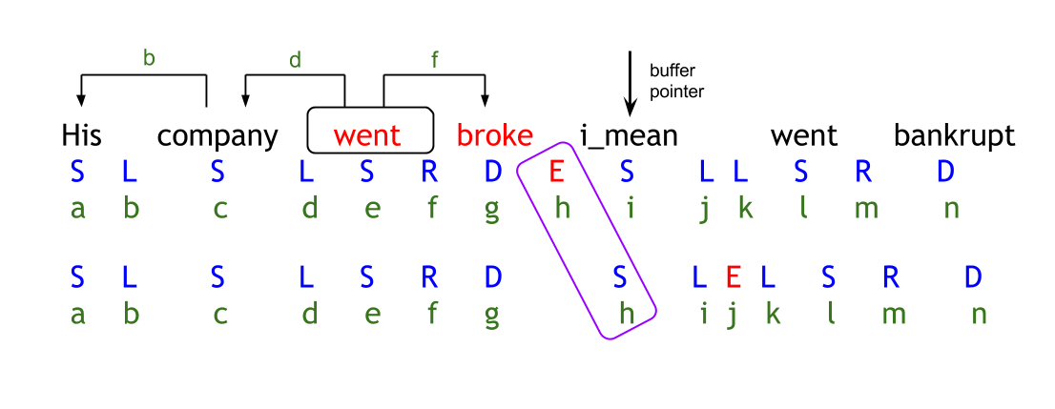
Motivation
Latent-structures (hidden info) are important in dependency parsing (Honnibal & Johnson, TACL 2014)
dynamic oracle
map a configuration to a set of transitions
partially annotated
latent variable

Slide 35
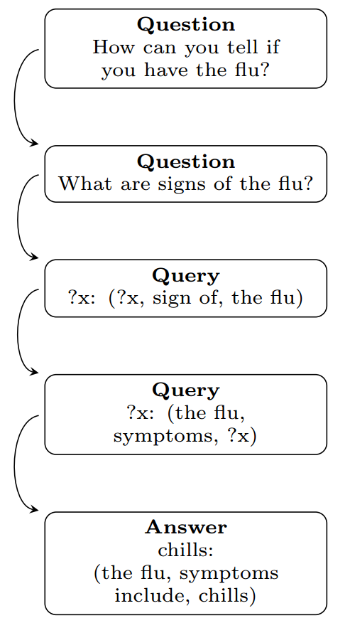
Motivation
Latent-structures (hidden info) are important in question answering (Fader et al., SIGKDD 2014)
Latent Variable

Slide 36
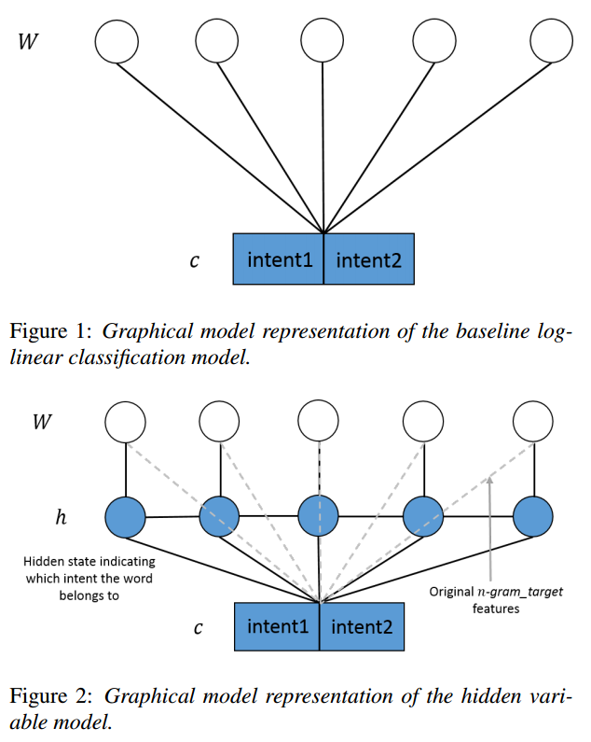
Motivation
Latent-structures (hidden info) are important in multi-intent speech recognition (Xu & Sarikaya, INTERSPEECH 2013)
Latent Variable

Slide 37
Challenges
Latent-structures (hidden info) are important in multi-intent speech recognition (Xu & Sarikaya, INTERSPEECH 2013)
Problem 1:
Annotating latent info requires much more tags and human time
→ Costly to annotate
Problem 2:
Different tasks have different latent info.
→ Hard to annotate

Slide 38
Latent-dynamic CRFs
A solution without additional annotation
Latent-dynamic CRFs (LDCRF)
[Morency et al., CVPR 2007; Sun et al., COLING 2008]
* No need to annotate latent info
Figure from Xu & Sarikaya, INTERSPEECH 2013.

Slide 39
Latent-dynamic CRFs
Latent-dynamic CRFs (LDCRF) (Morency et al., CVPR 2007; Sun et al., COLING 2008)
y₁
y₂
y₃
y₄
y_{n}
We can think (informally) it as
“CRF + unsup. learning on latent info”
h₁
h₂
h₃
h₄
h_{n}
LDCRF
x₁
x₂
x₃
x₄
x_{n}
y₁
y₂
y₃
y₄
y_{n}
Conditional random fields
x₁
x₂
x₃
x₄
x_{n}

Slide 40
Latent-dynamic CRFs
Latent-dynamic CRFs (LDCRF) (Morency et al., CVPR 2007; Sun et al., COLING 2008)
y₁
y₂
y₃
y₄
y_{n}
h₁
h₂
h₃
h₄
h_{n}
LDCRF
x₁
x₂
x₃
x₄
x_{n}

Slide 41
For Large-scale Structured Prediction
Latent-dynamic CRFs (LDCRF)
Training is slow
May need week-level time
Solution
Perceptron is much faster than CRF
Latent CRF -> Latent perceptron
Sun et al. Latent variable perceptron algorithm for structured classification. IJCAI 2009.
Sun et al. Latent structured perceptrons for large-scale learning with hidden information. TKDE 2013.

Slide 42
Latent Variable Perceptron
For fast training of latent variable models (Sun et al., IJCAI 2009; Sun et al., TKDE 2013)
Seg-0
Restricted Viterbi output by gold annotation
Seg-1
Seg-2
noSeg-0
Global Viterbi output
noSeg-1
noSeg-2
A related work on machine translation: Liang et al., 2006

Slide 43
Latent Variable Perceptron
For fast training of latent variable models (Sun et al., IJCAI 2009; Sun et al., TKDE 2013)
LDCRF:
{
Normally, batch training
(do weight update after go over all samples)
Latent variable perceptron (Sun et al., 2009) :
{
Online training
(do weight update on each sample)

Slide 44
Latent Variable Perceptron
LDCRF training method
Seg-0
Seg-1
Seg-2
noSeg-0
noSeg-1
noSeg-2
These are her flowers .

Slide 45
Latent Variable Perceptron
LDCRF training method
Seg-0
Seg-1
Seg-2
noSeg-0
noSeg-1
noSeg-2
These are her flowers .

Slide 46
Latent Variable Perceptron
Latent perceptron training
Seg-0
Seg-1
Seg-2
noSeg-0
noSeg-1
noSeg-2
These are her flowers .

Slide 47
Latent Variable Perceptron
Latent perceptron training
Seg-0
Restricted Viterbi output by gold annotation
Seg-1
Seg-2
noSeg-0
Global Viterbi output
noSeg-1
noSeg-2
These are her flowers .

Slide 48
Latent Variable Perceptron
Theoretical guarantee of convergence
As far as traditional perceptron is separable, latent structured perceptron is also separable.

Slide 49
Latent Variable Perceptron
Theoretical guarantee of convergence
Latent perceptron still converges

Slide 50
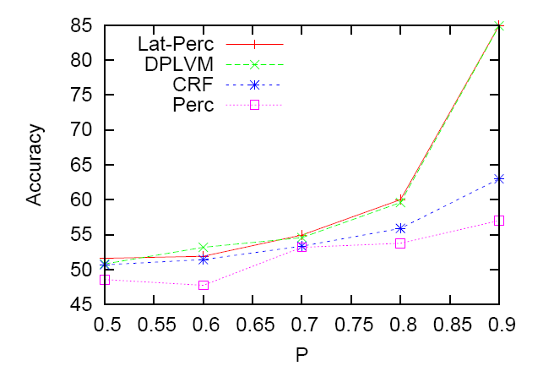
Latent Variable Perceptron
Experiment on synthetic data: Much better accuracy than CRF & Perceptron
Latent Perc
LDCRF
CRF
Averaged perceptron
Significance of latent info

Slide 51
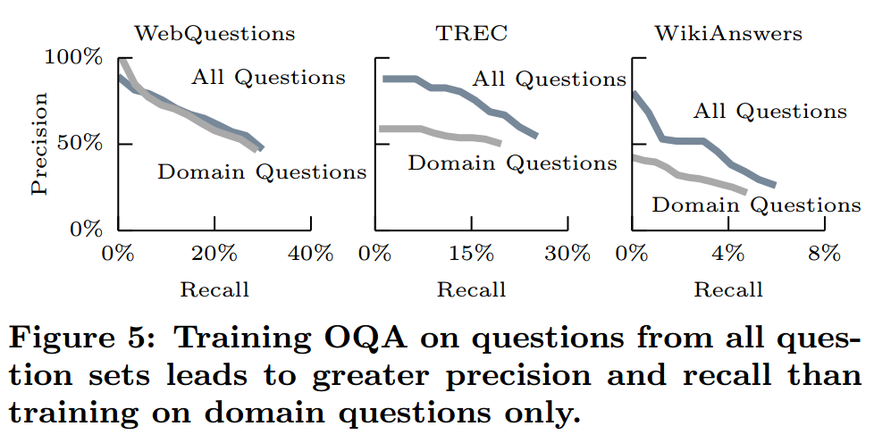
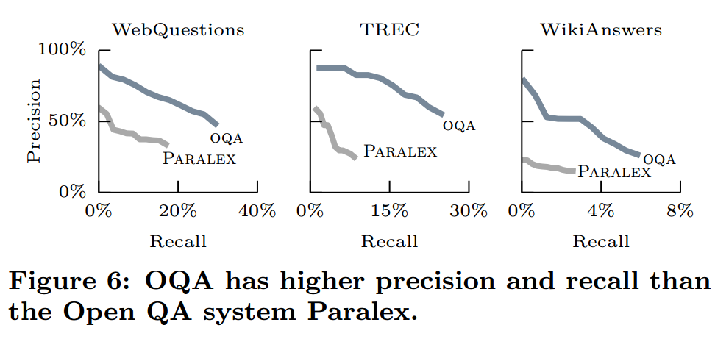
Latent Variable Perceptron
Good performance in question answering (Fader et al. SIGKDD2014)
Use query with partial anotation as latent variable
OQA is based on latent variable perceptron
(Sun et al., IJCAI 2009;
Sun et al., TKDE 2013)

Slide 52
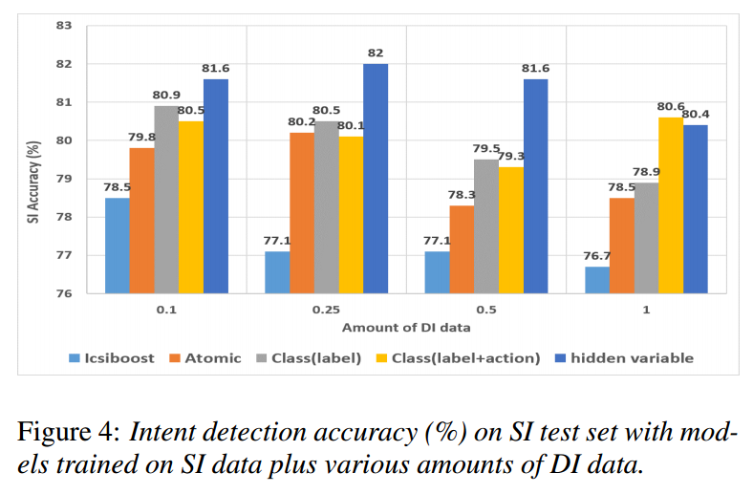
Latent Variable Perceptron
Good performance in speech sentence classification
(Xu & Sarikaya, INTERSPEECH 2013)
Split multi-intent using latent variable
Based on latent variable perceptron (Sun et al., IJCAI 2009; Sun et al., TKDE 2013)

Slide 53
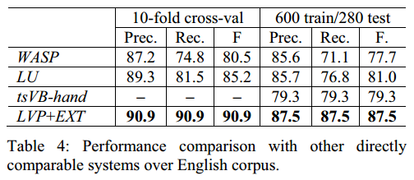
Latent Variable Perceptron
Good performance in semantic parsing (Zhou et al., IJCAI 2013)
Hybrid tree as latent structure variable
Based on latent variable perceptron (Sun et al., IJCAI 2009; Sun et al., TKDE 2013)
Better Performance

Slide 54
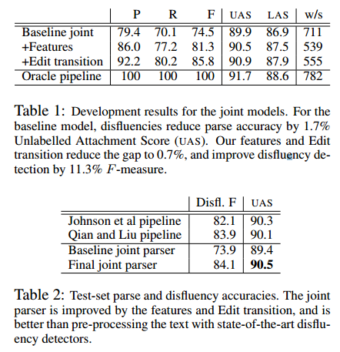
Latent Variable Perceptron
Good performance in dependency parsing (Honnibal & Johnson, TACL 2014)
Dynamic oracle/transitions as latent variable
Train with latent variable perceptron (Sun et al., IJCAI 2009; Sun et al., TKDE 2013)
Much better compared with baseline model

Slide 55
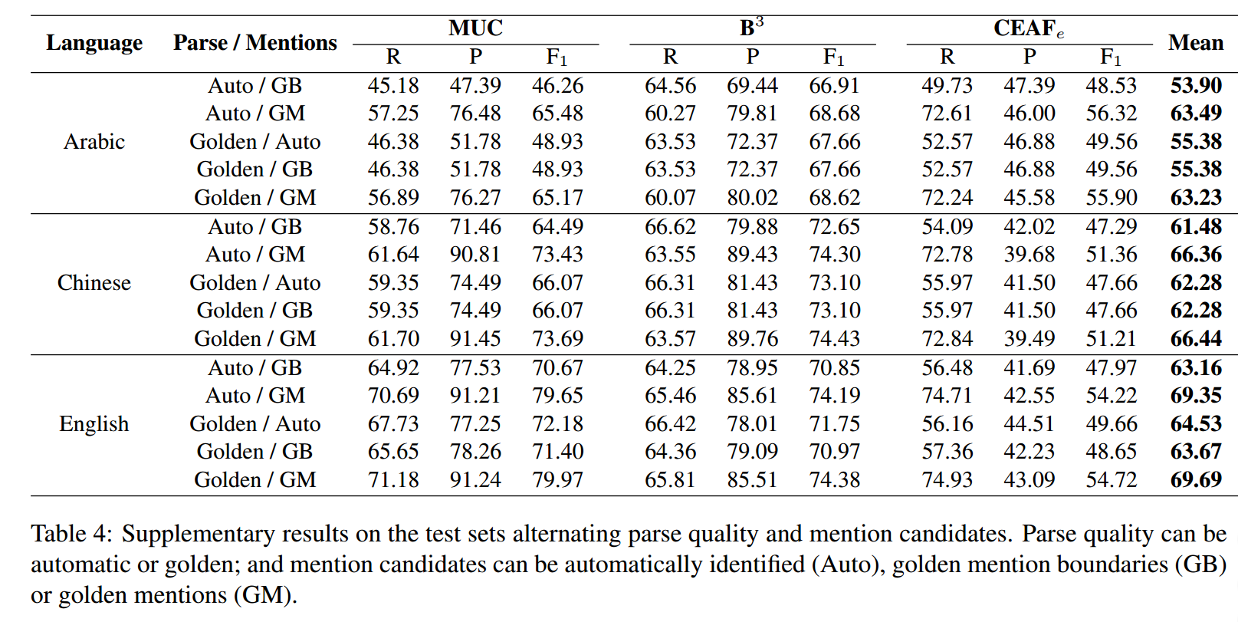
Latent Variable Perceptron
Good performance in coreference resolution
(Fernandes et al., CL 2012)
Use structures of coreference trees as latent variable
Based on latent variable perceptron (Sun et al., IJCAI 2009; Sun et al., TKDE 2013)

Slide 56
For Large-scale Structured Prediction
Latent Variable Perceptron
Proposed by Sun (2009, 2013)
Fast and accurate
Accuracy equal or even better than CRF
Almost as fast as perceptron
Suitable for large-scale structured prediction problems
Sun et al. Latent variable perceptron algorithm for structured classification. IJCAI 2009.
Sun et al. Latent structured perceptrons for large-scale learning with hidden information. TKDE 2013.

Slide 57
Outline
Latent Model can reduce annotation engineering
Furthermore, how to reduce the cost of feature engineering?
Neural Model
Automatically extract features

Slide 58
Outline
Conventional Model
Latent Model
Neural Model
Conditional Random Field
MIRA
Latent Dynamic CRF
Latent Variable Perceptron
LSTM-CRF
Recurrent Neural Network
Structured Perceptron
Probabilistic Perceptron
Long Short-term Memory
Reduce Annotation Engineering
Reduce
Feature Engineering
Latent Model
Conventional Model
Neural Model

Slide 59
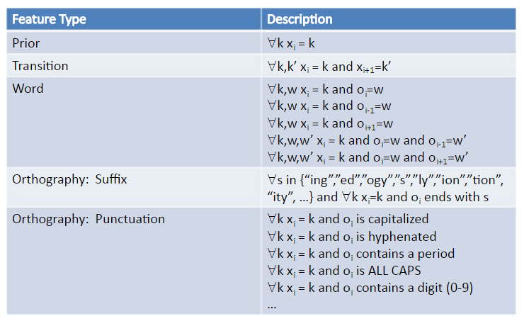
Motivation
Problem in feature engineering
Require linguistics knowledge
A lot of feature templates
Ad-hoc, some features are not very reasonable
Task-sensitive
Neural networks
Automatically learn features in hidden layers

Slide 60
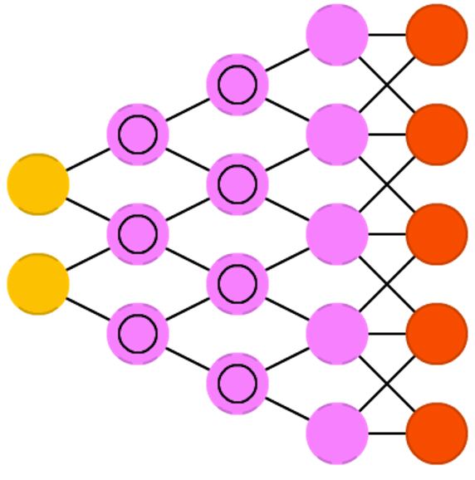
Neural Network
Many kinds
Feed Forward NN
logistic regression
Convolutional NN
image processing
Recursive/Recurrent NN
structured prediction

Slide 61
Recursive Neural Network
Recursive neural network (Socher et al., ICML 2011)
Model hierarchical structures
Condition on each sub-structure independently

Slide 62
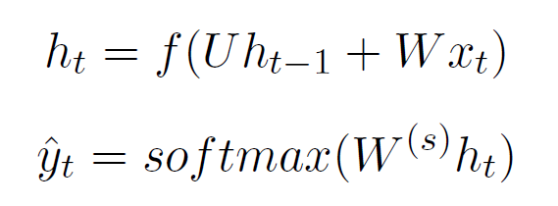
Recurrent Neural Network (RNN)
Recurrent neural network (Elman, Cognitive Science 1990)
Model time series
Predict linear-chain structures
Conditioned on all previous input
Picture from Christopher Olah

Slide 63
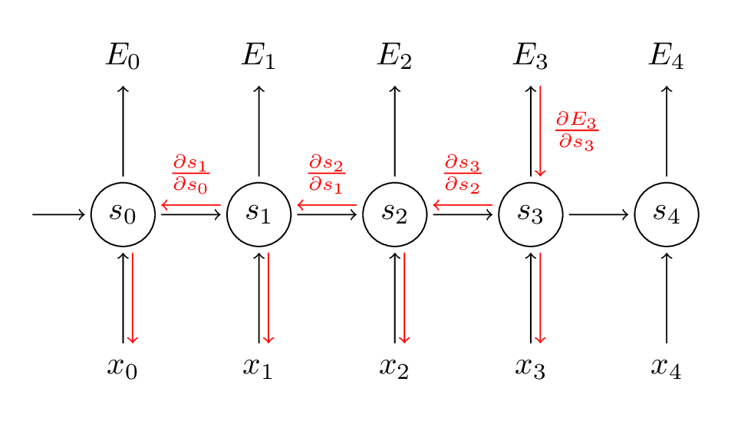
Recurrent Neural Network (RNN)
Problems
Gradient Exploding/Vanishing (Pascanu et al., ICML 2013)
Hard to capture long-term dependencies
Figure from Denny Britz

Slide 64
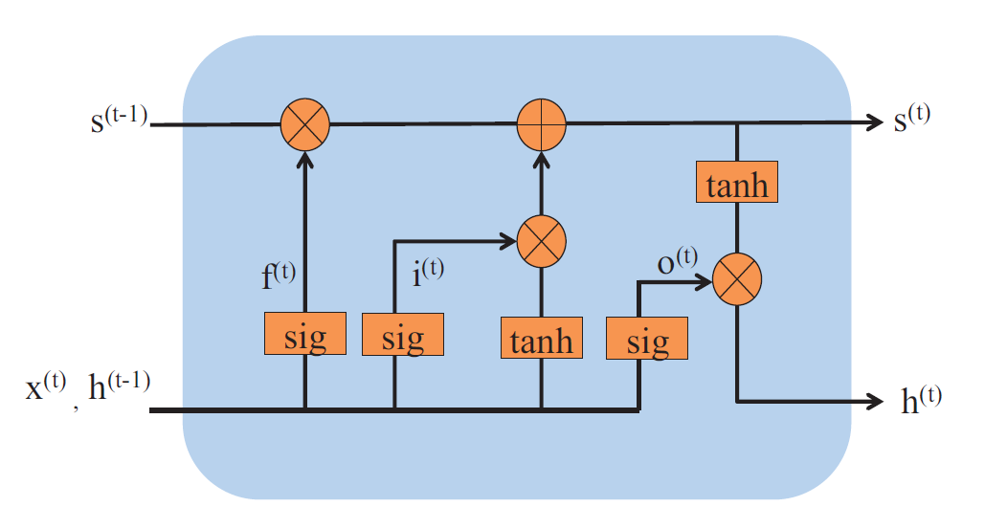
Long Short-term Memory (LSTM)
Long short-term memory (Hochreiter and Schmidhuber 1997)
A lasting linear memory
Capture long distance dependency
Three gates: input, forget and output gates
Control modification to the memory

Slide 65
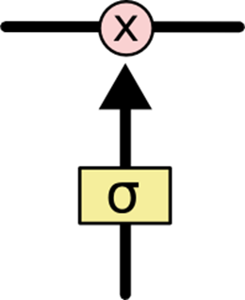
Introduction of Gates
Gate
Sigmoid-activated layer
Output value from 0 to 1
Member-wise multiplication
How much to flow through
Gates in LSTM
Forget gate
How much old memory needs to be remembered
Some Picture from Christopher Olah

Slide 66
Introduction of Gates
Gate
Sigmoid-activated layer
Output value from 0 to 1
Member-wise multiplication
How much to flow through
Gates in LSTM
Forget gate
How much old memory needs to be remembered
Input gate
Some Picture from Christopher Olah

Slide 67
Introduction of Gates
Gate
Sigmoid-activated layer
Output value from 0 to 1
Member-wise multiplication
How much to flow through
Gates in LSTM
Forget gate
How much old memory needs to be remembered
Input gate
Output gate
Some Picture from Christopher Olah

Slide 68
Introduction of Gates
RNN
Vanishing influence
LSTM
Situation-aware
Outputs
Outputs
Hidden Layer
Hidden Layer
Inputs
Inputs
Time
1
2
3
4
5
6
7
Time
1
2
3
4
5
6
7

Slide 69
Long Short-term Memory (LSTM)
Problem of LSTM
Can be slow for large models (hard to train)
Structure complexity is higher
Structure redundancy?
Too much parameters
Picture from Christopher Olah

Slide 70
Refinement of LSTM
Peepholes
Introduced by Gers (2000)
Include current memory when compute gates
Picture from Christopher Olah

Slide 71
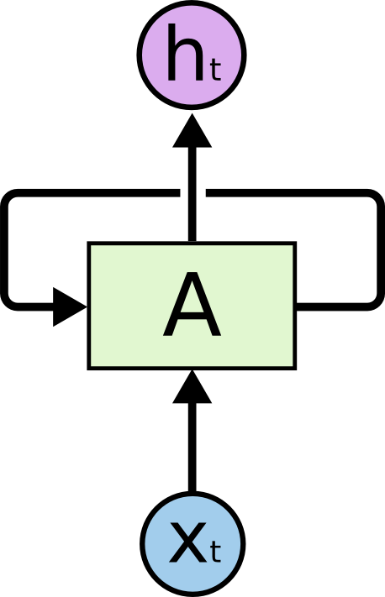
Refinement of LSTM
Fully connected gates
Included in Hochreiter and Schmidhuber (1997)
Gates are also recurrent
Picture from Christopher Olah

Slide 72
Refinement of LSTM
Gated recurrent unit (GRU)
Introduced by Chung et al. (2014)
Coupled forget and input gates with structure simplification
Picture from Christopher Olah

Slide 73
More recent development
Sequence to sequence neural network (Sutskever et al., NIPS 2014)
Encoder & Decoder
The encoder information is stored in a fixed-length vector
W
X
Y
Z
<EOS>
A
B
C
<EOS>
W
X
Y
Z
Encoder

Slide 74
More recent development
Sequence to sequence neural network (Sutskever et al., NIPS 2014)
Encoder & Decoder
The encoder information is stored in a fixed-length vector
Learn to align
Neural machine translation
W
X
Y
Z
<EOS>
A
B
C
<EOS>
W
X
Y
Z
Decoder

Slide 75
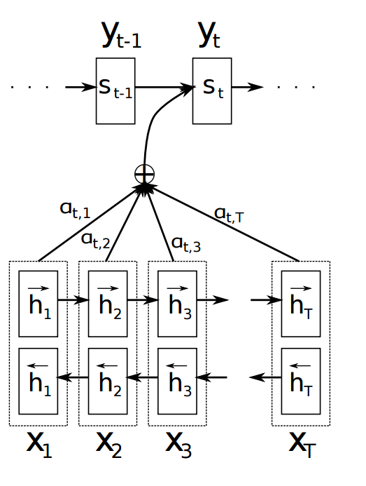
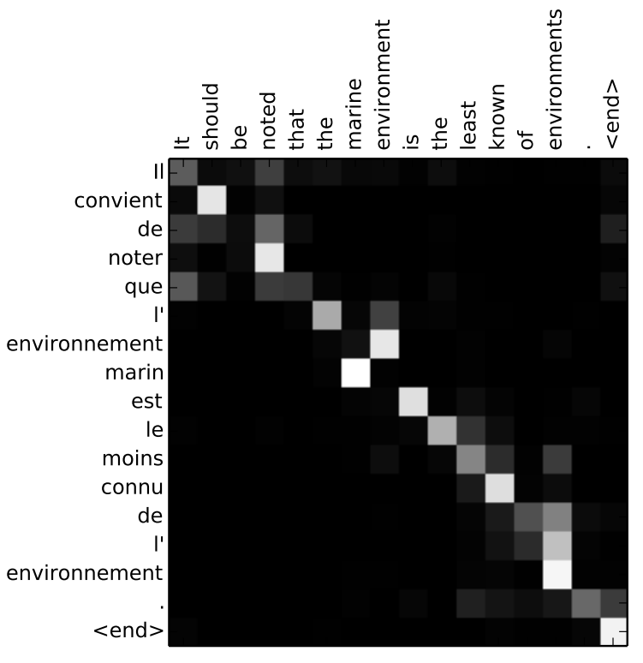
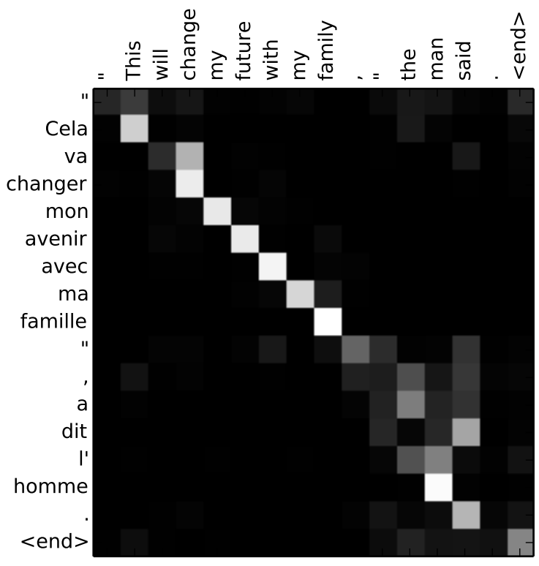
Structured Neural Network in Machine Translation
Attention-based neural network (Bahdanau et al. 2014; Luong et al. 2015)
Each hidden state has an unique weight/attention/importance

Slide 76
For Large-Scale Structured Prediction
Training large-scale neural models is costly
Numerous parameters
Very slow
A NMT model may take weeks (even months) to train
How to accelerate training speed?
Parallel training
Especially, asynchronous (lock-free) parallel training

Slide 77
Motivation
Neural networks -> Good Performance
CNN, RNN, LSTM…
Sequence labelling, parsing, machine translation…
Neural networks -> Slow Training
Large parameter space
Dense feature
Complex computation
Faster Training ? -> Parallel Training
Synchronous
Asynchronous -> AsynGrad

Slide 78
For Large-Scale Structured Prediction
Training large-scale neural networks is costly
Numerous parameters
Dense Feature
Time-consuming
For example
A NMT model may take weeks
to train
Days, even if with GPU clusters
How to accelerate training speed?
Parallel training
Especially, asynchronous (lock-free) parallel training
Notes:
需要图

Slide 79
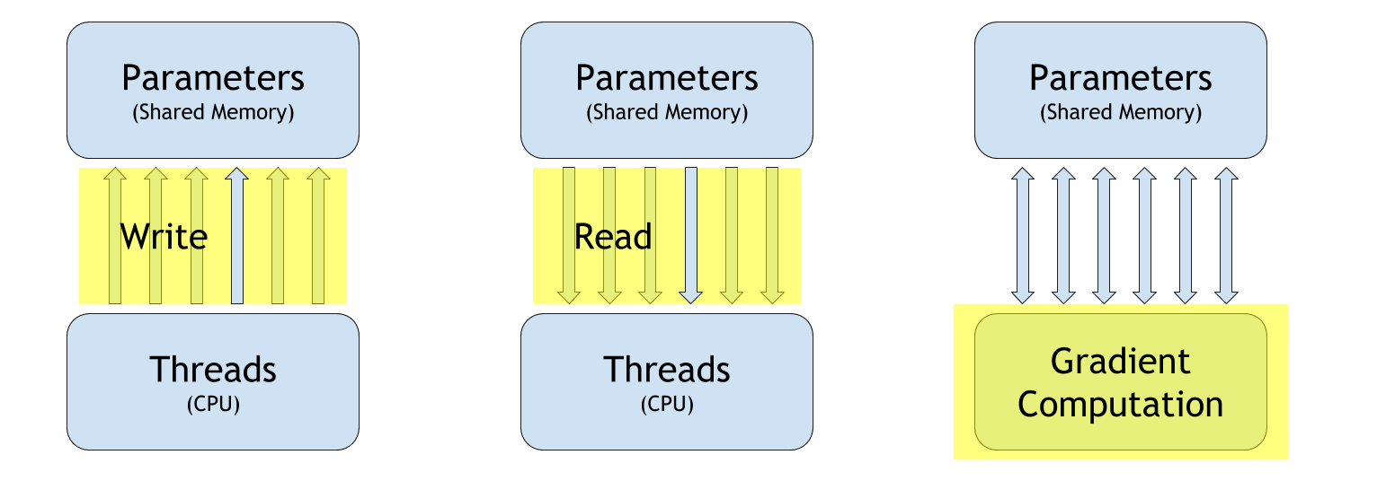
Problem Analysis
Basic operations in parallel training
Problem differs in
Online vs. Mini-batch vs. Batch
Synchronous parallel vs. Asynchronous parallel
Dense feature model vs. Sparse feature model

Slide 80
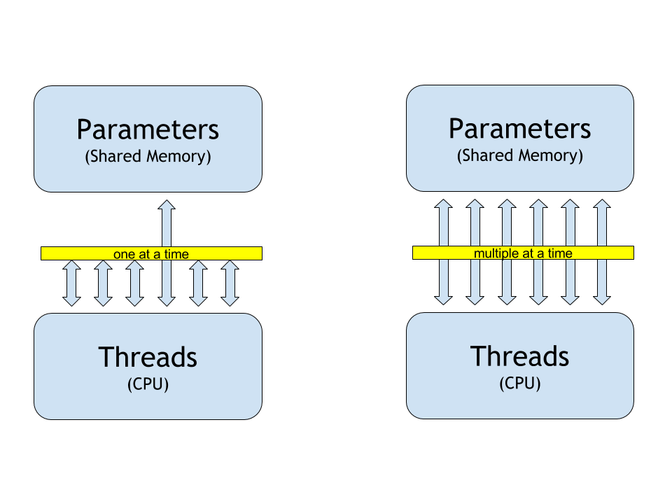
Parallel Training
Synchronous (locked)
Multiple threads
Only one can modify model parameters at the same time
Asynchronous (lock-free)
Multiple threads
Each one can modify model parameters at the same time

Slide 81
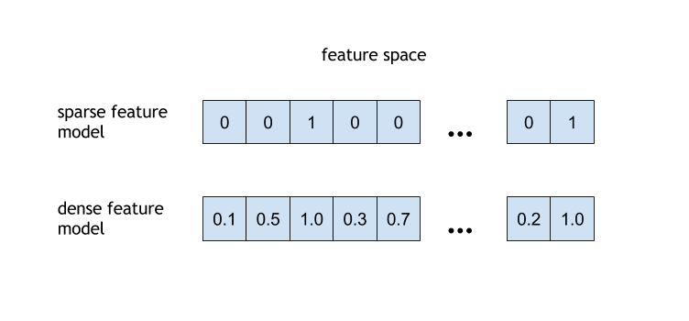
Model Types
Sparse feature model
e.g. HMM, CRF, Perceptron, MILA…
features are sparse
less read & write time
Dense feature model
e.g. RNN, LSTM, Sequence-to-Sequence…
features are dense
more read & write time

Slide 82
Problem Analysis
How threads interact with each other?
 | Sparse | Dense
Sync. | ? | ?
Async. | ? | ?

Slide 83
Problem Analysis
How threads interact with each other?
 | Sparse | Dense
Sync. | ? | ?
Async. | ? | ?

Slide 84
Synchronous Online Parallel Training
Correctness
Current approach: DSGD （round-robin）
Langford et al, NIPS 2009
Stochastic parallel learning by locking memory
No problem at all!
1. Simple case
Reading parameters from shared memory
Computing Gradients
Writing parameters to shared memory
Notes:
现有的同步方法

Slide 85
Synchronous Online Parallel Training
Correctness
Current approach:
mini-batch based method
Computing gradients in parallel
such as: parallel matrix operations via GPU
No problem at all!
1. Simple case
Reading parameters from shared memory
Computing Gradients
Writing parameters to shared memory
Notes:
现有的同步方法

Slide 86
Problem Analysis
How threads interact with each other?
 | Sparse | Dense
Sync.
Async. | ? | ?

Slide 87
Problem Analysis
How threads interact with each other?
 | Sparse | Dense
Sync.
Async. | ? | ?

Slide 88
Problem Analysis
How threads interact with each other?
 | Sparse | Dense
Sync.
Async. | ? | ?

Slide 89
Asynchronous Online Parallel Training
Asynchronous parallel learning is very popular for traditional sparse feature models
2. This case is called Gradient Delay case
→ More complicated, but problem solved for sparse feature models (Niu et al. NIPS 2011)

Slide 90
Asynchronous Online Parallel Training
Current approach: HogWild! and variants
Multiple threads updating parameters at the same time
For sparse feature models
Advantage
Actual parallel training
Fast training speed with no performance loss
Problem also solved (for sparse feature models)!

Slide 91
Problem Analysis
How threads interact with each other?
 | Sparse | Dense
Sync.
Async. |  | ?

Slide 92
Problem Analysis
How threads interact with each other?
 | Sparse | Dense
Sync.
Async. |  | ?

Slide 93
Problem Analysis
How threads interact with each other?
 | Sparse | Dense
Sync. | √ | √
Async. | √ | ?

Slide 94
Asynchronous Online Parallel Learning
3. Even more difficult case: Gradient Error Case
Happens for dense feature models, like neural networks
Actions (R, G & W) are time-consuming
Read-overwrite and write-overwrite problems
→Not well studied before, how to deal with this problem?
√

Slide 95
Problem Analysis
How threads interact with each other?
 | Sparse | Dense
Sync. | √ | √
Async. | √ | ?

Slide 96
Problem Analysis
How threads interact with each other?
 | Sparse | Dense
Sync. | √ | √
Async. | √
AsynGrad aims to
solve
gradient error case
AsynGrad

Slide 97
Problem Analysis
How threads interact with each other?
 | Sparse | Dense
Sync. | √ | √
Async. | √
This is our proposal
AsynGrad

Slide 98
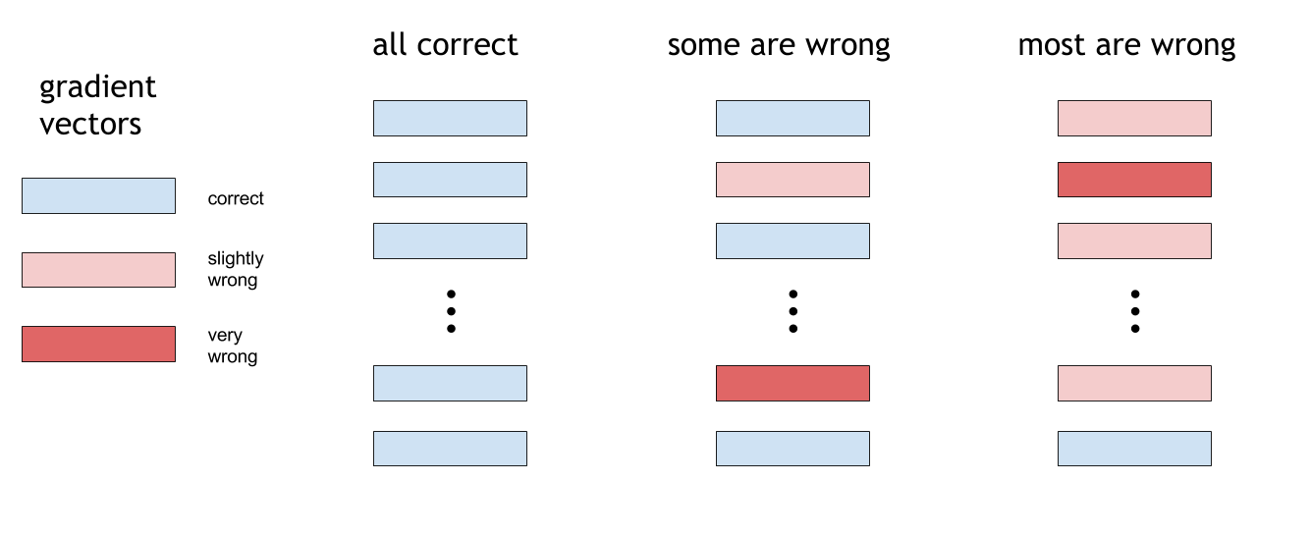
Review of Gradient Error Case
Gradient error has two aspects
How many of the gradients are wrong?
How wrong are they?

Slide 99
Experimental Observations
Gradient error is very common in asynchronous training of neural networks in real-world tasks

Slide 100
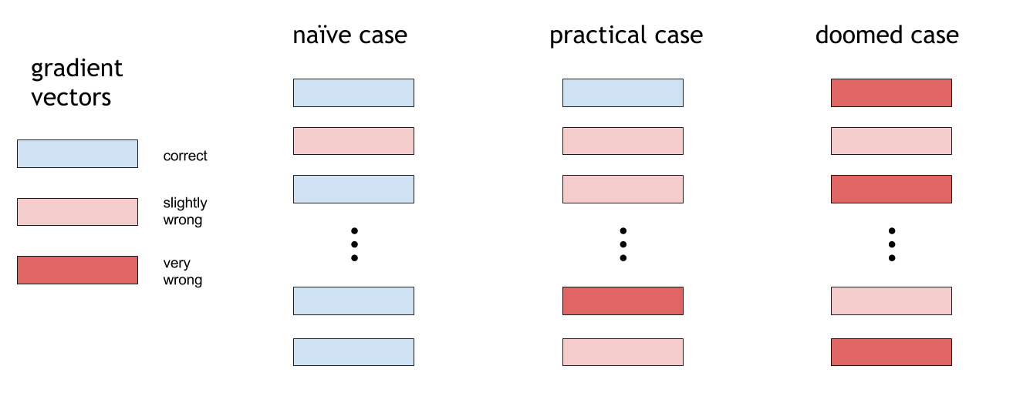
Experimental Observations
Gradient error is moderate in asynchronous training of neural networks in real-world tasks

Slide 101
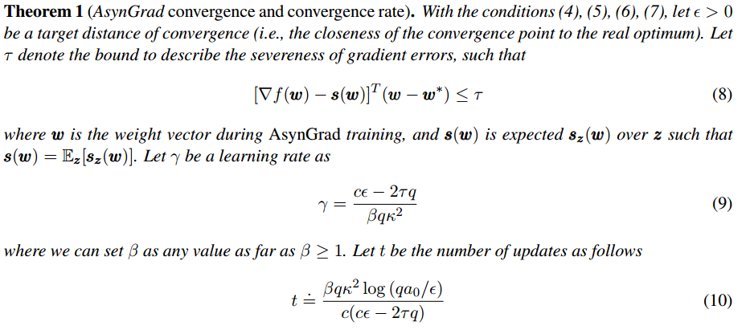
Our Theoretical Analysis
Can training still converge with gradient errors?
Even though there are gradient errors, training still converges towards the optimum, when the gradient errors are bounded.
bounded gradient errors

Slide 102
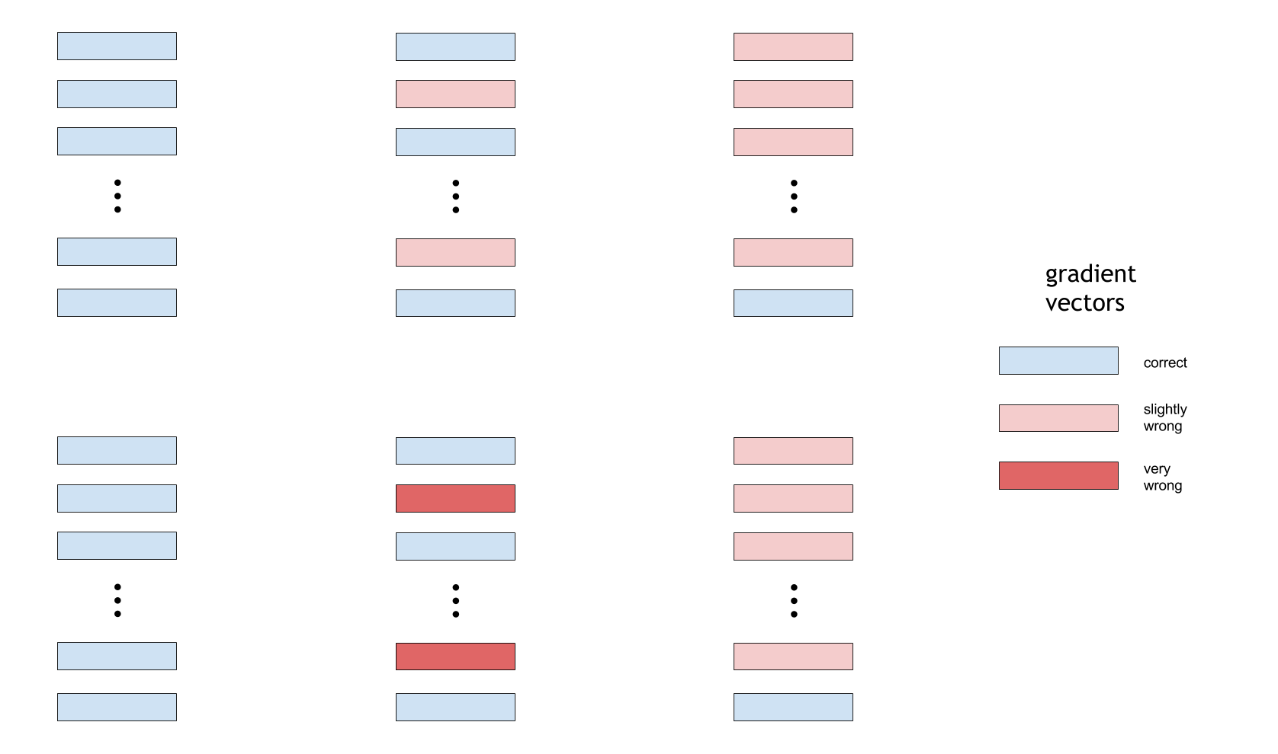
Our Theoretical Analysis
Even if most of the gradients are wrong
With their errors bounded, training still converge

Slide 103
AsynGrad
An asynchronous parallel learning solution for fast training of neural networks
Asynchronous Parallel Learning with Gradient Error (AsynGrad)
Algorithm
X. Sun. Asynchronous Parallel Learning for Neural Networks and Structured Models with Dense Features. COLING 2016.

Slide 104
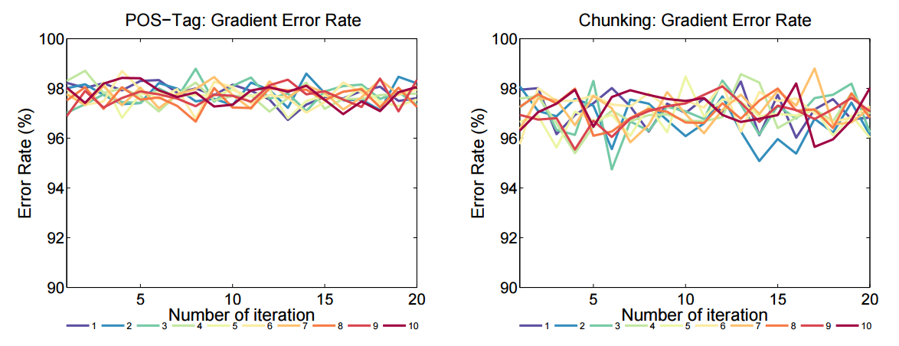
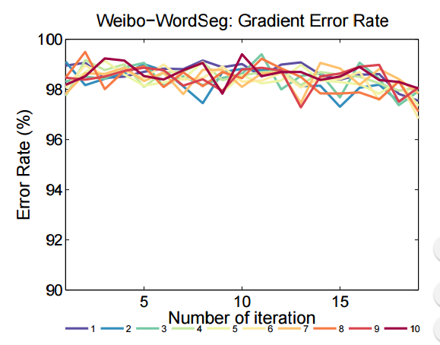
Experiments on LSTM
Experiments show a high gradient error rate

Slide 105
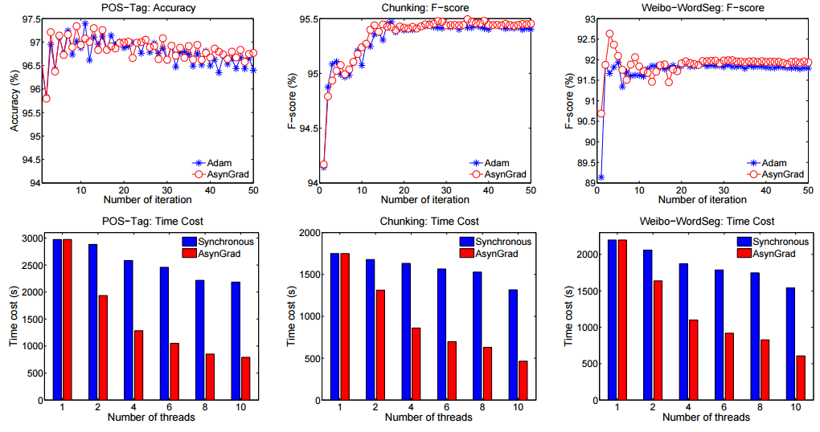
Experiments on LSTM
Experiments show that AsynGrad still converge even with a high gradient error rate

Slide 106
Experiments on LSTM
No loss on accuracy/F-score
With substantially faster training speed
AsynGrad

Slide 107
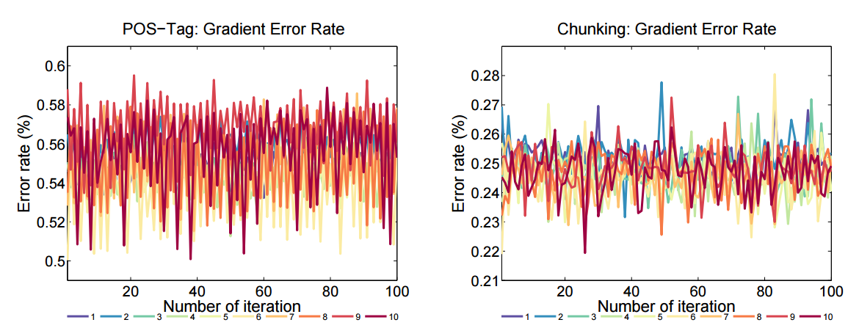
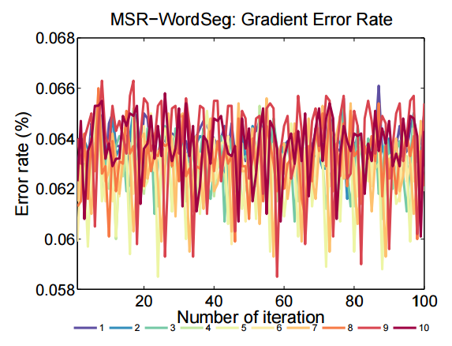
AsynGrad: A General-Purpose Solution
Also suitable for other dense feature models
Dense CRF -> moderate error rate

Slide 108
Experiments on Dense-CRF
No loss on accuracy/F-score
With substantially faster training speed
AsynGrad

Slide 109
Problem Analysis
How threads interact with each other?
 | Sparse | Dense
Sync. | √ | √
Async. | √ | ?

Slide 110
AsynGrad
Gradient errors are common and inevitable in asynchronous training of dense feature models
Such as neural networks
AsynGrad survives with gradient errors
With substantial faster training speed
No loss at all on test accuracy
Theoretical justification

Slide 111
Thanks!
Any questions until now?

Slide 112
Outline
Introduction
Model
Conventional Model
Latent Model
Neural Model
Regularization
How-tos

Slide 113
Overfitting
Models for large-scale structured prediction often suffer from overfitting
Overfitting
Low error rate in training set
High error rate in test set
Why overfitting?
Complex model
Too many parameters, too little data
How to deal with?
Penalty
Reduce complexity

Slide 114
Weight Regularization
Penalty parameters in loss function
$\min_{w}{loss\left(x,y,w\right)+λregularizer\left(w\right)}$
L1 regularizer
$regularizer= λ\left\|w\right\|$
$\frac{d}{dw_{j}}regularizer= λsign(w_{j})$
L2 regularizer
$regularizer= \frac{λ}{2}{\left\|w\right\|}^{2}$
$\frac{d}{dw_{j}}regularizer= λw_{j}$

Slide 115
Structure Regularization
Motivation
Reduce complexity of model structure
Structure regularization (Sun. NIPS 2014)
Complex structure -> Simple structure
Faster
Easy to implement
Theoretical guarantee

Slide 116
Illustration
Complex structures (high complexity)
Simple structures (low complexity)

Slide 117
Structure Regularization
Structure regularization (SR) can find good complexity
Simply split the structures!
Can (almost) be seen as a preprocessing step of the training data

Slide 118
Structure Regularization
Will the split causes feature loss? – loss of long distance features?
No loss of any (long distance) features
→ We can first extract features, then split the structures
→ Or, by simply copying observations to mini-samples, i.e., the split is only on tag-structures, like this:

Slide 119
Structure Regularization
Is structure regularization also required for test data?
No, no use of SR for testing data (in current implementation & experiments)
→Like other regularization methods, SR is only for the training
→i.e., No SR on the test stage (no decomposition of test samples)!

Slide 120
Structure Regularization
Structure & weight regularization
The implementation is very simple

Slide 121
Theoretical Analysis: Overfitting Risk
Expected risk
(risk on test data)
Empirical risk
(risk on training data)
Overfitting risk
(risk of overfitting from training data to test data)

Slide 122
Theoretical Analysis: Overfitting Risk
Complexity of structure (nodes of a training sample with structured dependencies)
→ Complex structure leads to higher overfitting risk

Slide 123
Theoretical Analysis: Overfitting Risk
Strength of structure regularization (strength of decomposition)
→ Stronger SR leads to reduction of overfitting risk

Slide 124
Theoretical Analysis: Overfitting Risk
Number of training samples
→ More training samples leads to reduction of overfitting risk

Slide 125
Theoretical Analysis: Overfitting Risk
Conclusions from our analysis:
Complex structure → low empirical risk & high overfitting risk
Simple structure → high empirical risk & low overfitting risk
Need a balanced complexity of structures

Slide 126
Theoretical Analysis: Overfitting Risk
In other words, more intuitively:
Too complex structure → high accuracy on training + very easy to overfit → low accuracy on testing
Too simple structure → very low accuracy on training + not easy to overfit → low accuracy on testing
Proper structure → good accuracy on training + not easy to overfit → high accuracy on testing

Slide 127
Theoretical Analysis: Overfitting Risk
Simple structure → low overfitting risk & high empirical risk
Complex structure → high overfitting risk & low empirical risk
Need a balanced complexity of structures
Some intuition in the proof (as in the full version paper):
1) The decomposition can improve stability
2) Better stability leads to better generalization (less overfitting)

Slide 128
Theoretical Analysis: Learning Speed
SR also with faster speed
(a by-product of simpler structures)
using structure regularization can quadratically accelerate the convergence rate

Slide 129
Some Advantages
If the original obj. function is convex, can still keep the convexity of the objective function
No conflict with the weight regularization
E.g, L2, and/or L1 regularization
General purpose and model-independent (because act like a preprocessing step)
E.g., can be used for different types of models, including CRFs, perceptrons, & neural networks

Slide 130
Experiments-1: Accuracy
State-of-the-art scores on competitive tasks

Slide 131
Experiments-2：Learning Speed
Also with faster speed
(a by-product of simpler structures)

Slide 132
For Large-scale Structured Prediction
Question: Is structure complexity matters in structured prediction?
Theoretical analysis to the question
1) Yes it matters
2) High complexity of structures → high overfitting risk
3) Low complexity → high empirical risk
4) We need to find an optimal complexity of structures
Proposed a solution
Split the original structure to find the optimal complexity
Better accuracies in real tasks, & faster (a by-product)
This work is published at NIPS 2014:
Xu Sun. Structure Regularization for Structured Prediction. In Advances in Neural Information Processing Systems (NIPS). 2402-2410. 2014

Slide 133
Drop Out
Proposed by Srivastava et al.(2014)
Part of neurons do not participate in forward pass and backpropagation
Only use in training
Advantage
Fewer parameters per training sample
Reduce training time

Slide 134
Drop Out
Experiment on MINST (Srivastava, et al. JMLR 2014)

Slide 135
Drop Out
Experiment on Penn Tree Bank (Zaremba, et al. 2015)
Language modeling measured by perplexity

Slide 136
Discussion of Techniques
StrutReg
decomposition of structure
randomly
LSTM
forget useless information
learned
Drop Out
deactivate neurons
randomly
ReLU
sparse activation
forced
Outputs
Hidden Layer
Inputs
Time
1
2
3
4
5
6
7
Picture credit: Christopher Olah

Slide 137
Discussion of Techniques
Struct Reg
Drop Out
LSTM
ReLU
Relations?
reduce complexity

Slide 138
Outline
Introduction
Model
Conventional Model
Latent Model
Neural Model
Regularization
How-tos

Slide 139
How to choose a model
Conventional models can achieve the state-of-the-arts results
stable for production setup
Latent models are good for tasks short of annotations
Neural models are promising
especially for high-level tasks
sentiment analysis
summarization, composition, translation
many nice frameworks available
theano, torch, tensorflow
caffe, cntk

Slide 140
How to Choose an Optimizer
For models other than neural models
Perceptron
online, fast convergence
For neural models
Mini-batch SGD
Using GPUs can lead to significant speed-ups, compared to use CPUs only
parameter-scaling
AdaGrad
AdaDelta
Adam
RMSProp
less tuning, fast
momentum-based
momentum
Nesterov Accelerated Gradient (NAG)
better results, more tuning

Slide 141
Visualization of Optimization Algorithms
Long Valley
Picture from Alec Radford
Notes:
Algorithms without scaling based on gradient information struggle to break symmetry here
SGD gets no where
Nesterov Accelerated Gradient / Momentum exhibits oscillations until they build up velocity in the optimization direction

Slide 142
Visualization of Optimization Algorithms
Saddle Point
Picture from Alec Radford
Notes:
NAG and Momentum like to explore around, almost taking a different path at the end
Adadelta/Adagrad/RMSProp proceed like accelerated SGD with more stability

Slide 143
Visualization of Optimization Algorithms
Beale's Function
Picture from Alec Radford
Notes:
Due to the large initial gradient, velocity based techniques shoot off and bounce around
adagrad almost goes unstable for the large initial gradient
Algorithms that scale gradients/step sizes like adadelta and RMSProp proceed more like accelerated SGD and handl large gradients with more stability.

Slide 144
Visualization of Optimization Algorithms
Noisy Data
Picture from Alec Radford
Notes:
with the momentum characteristic of the momentum-based algorithms, they show the smoothing effect, but also overshoot

Slide 145
Thanks! Any Question?

Slide 146
References And Further Reading
A. Fader, L. Zettlemoyer, and O. Etzioni. Open question answering over curated and extracted knowledge bases. SIGKDD 2014.
A. Graves. Neural Networks. Supervised Sequence Labelling with Recurrent Neural Networks. Springer 2012.
A. Krizhevsky, I. Sutskever, and G. Hinton. Imagenet classification with deep convolutional neural networks. NIPS 2012.
A. Passos, V. Kumar, and A. McCallum. Lexicon Infused Phrase Embeddings for Named Entity Resolution. CoNLL 2014.
A. Radford. http://imgur.com/s25RsOr/. 2014.
A. Radford. Visualizing optimization algors. http://imgur.com/a/Hqolp/. 2014.
A. Ratnaparkhi. A maximum entropy model for part-of-speech tagging. EMNLP 1996.
A. Søgaard. Semisupervised condensed nearest neighbor for part-of-speech tagging. ACL-HLT 2011.
C. Olah. Understanding LSTM networks. http://colah.github.io/posts/2015-08-Understanding-LSTMs/. 2015.
C. Olah. Visualizing representations: Deep learning and human beings. http://colah.github.io/posts/2015-01-Visualizing-Representations/. 2015.
C.D. Manning and H. Schütze. Foundations of Statistical Natural Language Processing. MIT Press 1999.
C.D. Manning and H. Schütze. Foundations of Statistical Natural Language Processing. MIT Press 1999.
C.D. Manning. Part-of-Speech Tagging from 97% to 100%: Is It Time for Some Linguistics? CICLing 2011.

Slide 147
References And Further Reading
D. Andor, C. Alberti, D. Weiss, A. Severyn, A. Presta, K. Ganchev, S. Petrov, and M. Collins. Globally normalized transition-based neural networks. arXiv:1603.06042.
D. Bahdanau, K. Cho, and Y. Bengio. Neural machine translation by jointly learning to align and translate. arXiv:1409.0473.
D. Biber, S. Conrad, and R. Reppen. Corpus linguistics: Investigating language structure and use. Cambridge University Press 1998.
D. Britz. Recurrent neural networks tutorial, part 3 - Backpropagation through time and vanishing gradients. http://www.wildml.com/2015/10/recurrent-neural-networks-tutorial-part-3-backpropagation-through-time-and-vanishing-gradients/. 2015.
D. Chen and C.D. Manning. A Fast and Accurate Dependency Parser using Neural Networks. EMNLP 2014.
D. Jurafsky and J.H. Martin. Speech and language processing. Prentice Hall 2008.
D. Klein and C.D. Manning. Accurate unlexicalized parsing. ACL 2003.
D. McClosky, E. Charniak, and M. Johnson. Effective Self-Training for Parsing. HLT-NAACL 2006.
E. Charniak and M. Johnson. Coarse-to-fine n-best parsing and MaxEnt discriminative reranking. ACL 2005.
E. Fernandes, C. dos Santos, and R. Milidiú. Latent trees for coreference resolution. CL 2014.
F. Gers. Long short-term memory in recurrent neural networks. PhD diss., Universität Hannover 2001.
F. Sha and F. Pereira. Shallow parsing with conditional random fields. HLT-NAACL 2003.
F.V. Veen. The neural network zoo. http://www.asimovinstitute.org/neural-network-zoo/. 2016.

Slide 148
References And Further Reading
H. Zhou, Y. Zhang, S. Huang, and J. Chen. A neural probabilistic structured-prediction model for transition-based dependency parsing. ACL 2015.
H.L. Chieu. Named entity recognition with a maximum entropy approach. CoNLL 2003.
I. Sutskever, O. Vinyals, and Q. Le. Sequence to sequence learning with neural networks. NIPS 2014.
J. Chung, Ç. Gülçehre, K. Cho, and Y. Bengio. Empirical evaluation of gated recurrent neural networks on sequence modeling. arXiv:1412.3555.
J. Earley. An efficient context-free parsing algorithm. Communications of the ACM 1970.
J. Giménez and L. Marquez. SVMTool: A general POS tagger generator based on Support Vector Machines. LREC 2004.
J. Koutník, K. Greff, F. Gomez, and J. Schmidhuber. A clockwork rnn. ICML 2014.
J. Lafferty, A. McCallum, and F. Pereira. Conditional random fields: Probabilistic models for segmenting and labeling sequence data. ICML. 2001.
J. Martens. Deep learning via Hessian-free optimization. ICML 2010.
J. Nivre and M. Scholz. Deterministic dependency parsing of English text. COLING 2004.
J. Nivre. An efficient algorithm for projective dependency parsing. IWPT 2003.
J. Zhou, J. Xu, and W. Qu. Efficient Latent Structural Perceptron with Hybrid Trees for Semantic Parsing. IJCAI 2013.
J.L Elman. Finding structure in time. Cognitive science 1990.

Slide 149
References And Further Reading
K. Crammer, O. Dekel, J. Keshet, S. Shalev-Shwartz, and Y. Singer. Online passive-aggressive algorithms. JMLR 2006.
L. Huang, S. Fayong, and Y. Guo. Structured perceptron with inexact search. HLT-NAACL 2012.
L. Morency, A. Quattoni, and T. Darrell. Latent-dynamic discriminative models for continuous gesture recognition. CVPR 2007.
L. Shen, G. Satta, and A. Joshi. Guided learning for bidirectional sequence classification. ACL 2007.
M. Bates. Models of natural language understanding. NAS 1995.
M. Collins and B. Roark. Incremental parsing with the perceptron algorithm. ACL 2004.
M. Collins. Discriminative training methods for hidden markov models: Theory and experiments with perceptron algorithms. ACL 2002.
M. Collins. Head-driven Statistical Models for Natural Language Parsing. PhD Thesis 1999.
M. Collins. Incremental parsing with the perceptron algorithm. ACL 2004.
M. Collins. Three generative, lexicalised models for statistical parsing. EACL 1997.
M. Honnibal and M. Johnson. Joint incremental disfluency detection and dependency parsing. TACL 2014.
M.A.K Halliday. Language structure and language function. New horizons in linguistics 1970.
M.T. Luong, H. Pham, and C.D. Manning. Effective approaches to attention-based neural machine translation. EMNLP 2015.

Slide 150
References And Further Reading
N. Chomsky. Knowledge of language: Its nature, origin, and use. Greenwood Publishing Group 1986.
N. Chomsky. Language and mind. Cambridge University Press 2006.
N. Chomsky. Reflections on language. New York 1975.
N. Srivastava, G. Hinton, A. Krizhevsky, I. Sutskever, and R. Salakhutdinov. Dropout: a simple way to prevent neural networks from overfitting. JMLR 2014.
P. Liang, A. Bouchard-Côté, D. Klein, and B. Taskar. An End-to-End Discriminative Approach to Machine Translation. ACL 2006.
P. Xu and R. Sarikaya. Exploiting shared information for multi-intent natural language sentence classification. INTERSPEECH 2013.
R. Collobert, J. Weston, L. Bottou, M. Karlen, K. Kavukcuoglu, and P. Kuksa. Natural language processing (almost) from scratch. JMLR 2011.
R. Florian, A. Ittycheriah, H. Jing, and T. Zhang. Named entity recognition through classifier combination. HLT-NAACL 2003.
R. McDonald and F. Pereira. Online learning of approximate dependency parsing algorithms. EACL 2006.
R. McDonald, F. Pereira, K. Ribarov, and J. Hajic. Non-projective dependency parsing using spanning tree algorithms. HLT-EMNLP 2005.
R. McDonald, K. Crammer, and F. Pereira. Flexible text segmentation with structured multilabel classification. HLT-EMNLP 2005.
R. Pascanu, T. Mikolov, and Y. Bengio. On the difficulty of training recurrent neural networks. ICML 2013.

Slide 151
References And Further Reading
R. Socher, A. Perelygin, J. Wu, J. Chuang, C.D. Manning, A. Ng, and C. Potts. Recursive deep models for semantic compositionality over a sentiment treebank. EMNLP 2013.
R. Socher, C. Lin, A. Ng, and C.D. Manning. Parsing natural scenes and natural language with recursive neural networks. ICML 2011.
R. Wardhaugh. Introduction to Linguistics. Mc-Graw-Hill Book Company. 1972.
R.K. Ando and T. Zhang. A framework for learning predictive structures from multiple tasks and unlabeled data. JMLR 2005.
S. Hochreiter and J. Schmidhuber. Long short-term memory. Neural computation 1997.
S. Petrov and D. Klein. Improved inference for unlexicalized parsing. NAACL 2007.
S. Petrov and D. Klein. Sparse multi-scale grammars for discriminative latent variable parsing. EMNLP 2008.
T. Kudo T and Y. Matsumoto. Chunking with support vector machines. NAACL 2001.
T.Matsuzaki, Y. Miyan, and J. Tsujii. Probailistic CFG with latent annotations. ACL 2005.
T. Robertshaw. Introduction to machine learning with naive bayes. http://tomrobertshaw.net/2015/12/introduction-to-machine-learning-with-naive-bayes/. 2015.
V. Nair and G.E. Hinton. Rectified linear units improve restricted Boltzmann machines. ICML 2010.
X. Sun. Asynchronous Parallel Learning for Neural Networks and Structured Models with Dense Features. COLING 2016.

Slide 152
References And Further Reading
X. Sun, L. Morency, D. Okanohara, Y. Tsuruoka, and J. Tsujii. Modeling latent-dynamic in shallow parsing: a latent conditional model with improved inference. COLING 2008.
X. Sun, T. Matsuzaki, and W. Li. Latent structured perceptrons for large-scale learning with hidden information. TKDE 2013.
X. Sun, T. Matsuzaki, D. Okanohara, and J. Tsujii. Latent variable perceptron algorithm for structured classification. IJCAI 2009.
X. Sun. Structure regularization for structured prediction. NIPS 2014.
X. Sun. Towards shockingly easy structured classification: A search-based probabilistic online learning framework. arXiv:1503.08381.
Y. Zhang and J. Nivre. Transition-based dependency parsing with rich non-local features. ACL-HLT 2011.
Y. Zhang and S. Clark. A tale of two parsers: investigating and combining graph-based and transition-based dependency parsing using beam-search. EMNLP 2008.
Z. Huang, W. Xu, and K. Yu. Bidirectional LSTM-CRF Models for Sequence Tagging. arXiv:1508.01991.

Slide 153
Content And Lecturer
Models & Regularization
Conventional Model
Structures & Applications
Latent Model
Neural Model
Sequence Structure
Tree/Graph Structure
Xu SUN
Yansong FENG

Slide 154
Type of Structures in Application
Yansong FENG
Peking University
fengyansong@pku.edu.cn

Slide 155
Outline
Sequence Tagging
Tree/Graph Structure
Take-home Msg

Slide 156
Outline
Sequence Tagging
Chinese Word Segmentation
POS Tagging/Named Entity Recognition
Tree/Graph Structure
Take-home Msg

Slide 157
Sequence Tagging
Sequence
the most basic/simplest structures in NLP
Tag each item in the sequence using a given label set
Common to see
World segmentation
Part-of-Speech tagging
Named entity recognition
Chunking
Event trigger identification
…

Slide 158
Sequence Tagging
Conventional models
CRF, Structured perceptron, …
Work well, but
Feature engineering
Local context / Global information
…
Neural models
CNN, RNN, LSTM, LSTM-CRF,…
Performances
Comparable to state of the arts
Combinations may give top performances

Slide 159
Chinese Word Segmentation
The Task
地面 积 了 厚厚 的 雪 (The ground is covered with thick snow)
这 块 地 面积 还 真 不小 (This area is really not small)
Challenges
Feature engineering
Long distance dependencies
Neural Network Practice
CNN/RNN to capture local information, instead of fixed windows
RNN to capture long distance dependencies, or sentence-level/global information
[Xu and Sun, 2016]

Slide 160
Model Local Information
NN to model local features
TNN to capture tag/word features and their combinations
CNN, RNN, LSTM, BLSTM to capture local features, beyond fixed window size
Choice of character/word level
Word level features are still important, but not easy to incorporate in models
Explore word level information in a beam-search framework [Zhang et al., 2016, Cai and Zhao, 2016]
Word level features give 0.5%
Combinations
Combining neural and discrete features gives top performances

Slide 161
Global View
Long Distance Dependencies
Gated Recursive NN [Chen et al., 2015, Xu and Sun, 2016]
LSTM [Chen et al., 2015b, Zhang et al., 2016, Cai and Zhao, 2016]
Search Strategy
CRF framework
Viterbi
Beam-search style
Fully explore word level information
Transition based [Zhang et al., 2016]
Beam search [Cai and Zhao, 2016]

Slide 162
Models
Gated Recursive Neural Networks
Dependency based Gated Recursive Neural Networks
[Chen et al., 2015a]
[Xu and Sun, 2016]

Slide 163
Models
LSTM
LSTM + Gated Combination Neural Networks
Bi-LSTM
[Chen et al., 2015b]
[Cai and Zhao, 2016]

Slide 164
Performances on Benchmarks
Conventional models are still strong
Neural models can be promising, and sometimes complementary to conventional models
Long distance dependencies
Word level features
BiLSTM works to capture local context information
Various NN models to sentence level/long-distance information
CRF is still attractive

Slide 165
On PKU and MSR

Slide 166
POS/NER/Chunking
Typical Sequence Labeling tasks
Conventional models have achieved over ~90%
Again
Feature engineering
Language issues
Local/Global
Label bias
Neural Network Practice
BLSTM/CNN to capture local context, both forward and backward
CRF with Viterbi to find the best sequence

Slide 167
Feature Extraction
NN models seem be capable of handling language issues to some extent
CNN
BLSTM → Dominating!
Character level modeling
BLSTM works better than LSTM
Look at both past and future
Traditional lexicon features are still there
Extra resources, like dictionary, gazetteers, or Wiki, are always welcome

Slide 168
Models
BLSTM-CRF with feature concatenation
work nice for POS, NER, Chunking
[Huang et al., 2015]

Slide 169
Models
Typical BLSTM-CRF for POS / NER
Word / Character Level
[Ling et al., 2015]
[Lample et al., 2016]

Slide 170
Models
BLSTM+CNN for NER
[Chiu and Nicols., 2016]

Slide 171
Language Issues
Handling with different languages
Handling with OOV
using CNN
character-level modeling
[dos Santos and Guimaraes, 2015]
[Ling et al., 2015]

Slide 172
POS Tagging On WSJ

Slide 173
NER On CoNLL

Slide 174
Misc
Event Trigger Identification
犯 罪 嫌 疑 人 都 落 入 法 网
The suspects were arrested [arrest_jail]
NN models work to help
Feature extraction
Both local and global features (CNN, BLSTM)
Language issues: character level modeling

Slide 175
Models
BLSTM+CNN for event trigger identification
CNN to capture local context
[Zeng et al., 2016]

Slide 176
Outline
Sequence Tagging
Tree/Graph Structure
Dependency Parsing
Semantic Role Labelling
Take-home Message

Slide 177
Tree/Graph Structures
One of most common/important structures in NLP
Both the tree/graph structures and their tags are latent
Building bricks
Syntactic parsing
Event extraction
Semantic role labeling
…

Slide 178
Dependency Parsing
The Task
Conventional Models
Transition based
Graph based
However,
Feature engineering
Label bias ----> locally/globally normalized
Neural Network Practice
Transition/Graph based
NN models to extract various features
choose from greedy search, beam search or approximate global normalization

Slide 179
Transition based models
Most DL based works in dependency parsing follows the transition based framework.
lower complexity
higher efficiency
more choices of features
Follow normal transition styles
but, most are based on greedy search
Various NN models used to produce dense features
normal NNs
LSTM
BLSTM, both word level and character level
[Chen and Manning, 2014], [Weiss et al., 2015], [Dyer et al., 2015], [Ballesteros et al., 2015], [Zhou et la., 2015], [Kiperwasser and GoldBerg, 2016], [Andor et al., 2016]

Slide 180
Features
Key features, such as words, POS and dep labels, as well as their combinations can be transformed into dense format through a neural network
[Chen and Manning, 2014]

Slide 181
Features
Or, features could be captured through LSTM units
[Dyer et al., 2015] [Ballesteros et al., 2015]
[Kiperwasser and GoldBerg, 2016]

Slide 182
Greedy Search
No global considerations about future decisions
look ahead with limited context
label bias
May be error propagations
Training a global normalized model may not be trivial
Complexity
Space
And, it is found that, in many parsers, beam search has minimal impact in the results. [Dyer et al., 2015]
However, sometimes, better than beam-search based methods [Kiperwasser and GoldBerg, 2016]

Slide 183
Beam Search
One solution is to use the output layers of the NN model to learn a structured perceptron with a beam search
gives 0.8%
[Weiss et al., 2015]

Slide 184
Approximate Global Normalization
Local normalized models may suffer from local optimal (greedy search), label bias, etc.
Perform global normalization exactly
maximize the whole action sequence
It is not trivial !
too many possible action sequences
expensive (impossible) to enumerate and compute
Or, do it approximately ?

Slide 185
Approximate Global Normalization
Contrastive Learning [Hinton, 2002; LeCun and Huang, 2005; Liang and Jordan, 2008; Vickrey et al., 2010]
reward observed data
penalize noisy data
In the beam search case:
Give gold sequence with higher probability
Give incorrect sequences in the beam with lower probabilities
Early update may be helpful
gives more than 1.5%
[Zhou et al., 2014]

Slide 186
Approximate Global Normalization
The importance of looking ahead
[Andor et al., 2016]

Slide 187
Approximate Global Normalization
Global Training
Backward propagation with beam search
with early update
slow
Works for multiple tasks:
Dependency parsing
POS tagging
Sentence Compression
Insight:
Global models are more expressive
[Andor et al., 2016]

Slide 188
On WSJ

Slide 189
Semantic Role Labeling
The Task
[He_{A0} ] had trouble raising [funds_{A1} ]. [Roth and Lapata, 2016]
Conventional Models
Pipeline
predicate identification, argument identification, argument classification
However,
Feature engineering, local features, global features, …
Pipeline
Neural Practice
NN models to extract various features, or as local classifiers
In a sequence labeling style, an End-to-End system

Slide 190
Pipeline System
Step by step: predicate identification, argument identification, argument classification
Each step: local classifiers with feature extraction, using CNN, or LSTM
CNN
LSTM
[Fortland and Martin, 2015]
[Roth and Lapata, 2016]

Slide 191
End-to-End System
Multi-Layered LSTM with CRF to Sequence Tagging.
[Zhou and Xu, 2016]

Slide 192
CNN v.s. LSTM
Handle long distance dependencies
CNN
good at capturing local features, or work on dependency path
not so good at End-to-End systems, or extracting features from plain word sequence for SRL
LSTM
good at capturing both local features, and global information, either for local decisions, or sentence level re-ranking
more powerful in capturing features of various levels
deep LSTM can also be used to build End-to-End SRL systems

Slide 193
Outline
Sequence Tagging
Tree/Graph Structure
Take-home Messages

Slide 194
How-tos
Standard settings for Sequence Tagging
BLSTM + CRF
character modeling or CNN for fine modeling
fused with successful traditional features
perhaps, beam search for various features
But Use as many useful resources as you can !
More complex structures
BLSTM + Transition base systems
choose from greedy search / beam search
But
Choose globally normalized models if you can!

Slide 195
Thanks

Slide 196
Reference
Alexandre Passos, Vineet Kumar, Andrew McCallum, Lexicon Infused Phrase Embeddings for Named Entity Resolution, In Proceedings of the Eighteenth Conference on Computational Language Learning, pages 78–86, Baltimore, Maryland USA, June 26-27 2014.
Chris Alberti, David Weiss, Greg Coppola, and Slav Petrov. 2015. Improved transition-based parsing and tagging with neural networks. In Proceedings of the 2015 Conference on Empirical Methods in Natural Language Processing, pages 1354–1359.
Chris Dyer, Miguel Ballesteros, Wang Ling, Austin Matthews, and Noah A. Smith. 2015. Transition-based dependency parsing with stack long short-term memory. In Proceedings of the 53rd Annual Meeting of the Association for Computational Linguistics, pages 334–343.
Cıcero dos Santos and Victor Guimaraes, Boosting Named Entity Recognition with Neural Character Embeddings, In Proceedings of the Fifth Named Entity Workshop, joint with 53rd ACL and the 7th IJCNLP, pages 25–33, Beijing, China, July 26-31, 2015.
Cıcero Nogueira dos Santos and Bianca Zadrozny, Learning Character-level Representations for Part-of-Speech Tagging, In Proceedings of the 31st International Conference on Machine Learning, Beijing, China, 2014.
Daniel Andor, Chris Alberti, David Weiss, Aliaksei Severyn, Alessandro Presta, Kuzman Ganchev, Slav Petrov and Michael Collin, Globally Normalized Transition-Based Neural Networks, Proceedings of the 54th Annual Meeting of the Association for Computational Linguistics, pages 2442–2452, Berlin, Germany, August 7-12, 2016
Danqi Chen and Christopher D. Manning. 2014. A fast and accurate dependency parser using neural networks. In Proceedings of the 2014 Conference on Empirical Methods in Natural Language Processing, pages 740–750.
David Weiss, Chris Alberti, Michael Collins, and Slav Petrov. 2015. Structured training for neural network transition-based parsing. In Proceedings of the 53rd Annual Meeting of the Association for Computational Linguistics, pages 323–333.

Slide 197
Reference
Deng Cai and Hai Zhao, Neural Word Segmentation Learning for Chinese, In Proceedings of the 54th Annual Meeting of the Association for Computational Linguistics, pages 409–420, Berlin, Germany, August 7-12, 2016
Eliyahu Kiperwasser and Yoav Goldberg, Simple and Accurate Dependency Parsing Using Bidirectional LSTM Feature Representations, arXiv:1603.04351v2
Hao Zhou, Yue Zhang, and Jiajun Chen. 2015. A neural probabilistic structured-prediction model for transition-based dependency parsing. In Proceedings of the 53rd Annual Meeting of the Association for Computational Linguistics, pages 1213–1222.
In Transactions of the Association for Computational Linguistics, vol. 4, pp. 357–370, 2016
Jason P.C. Chiu and Eric Nichols, Named Entity Recognition with Bidirectional LSTM-CNNs,
Jie Zhou and Wei Xu. 2015. End-to-end learning of semantic role labelling using recurrent neural networks. In Proceedings of the 53rd Annual Meeting of the Association for Computational Linguistics and the 7th International Joint Conference on Natural Language Processing, pages 1127–1137.
Jingjing Xu and Xu Sun, Dependency-based Gated Recursive Neural Network for Chinese Word Segmentation, In Proceedings of the 54th Annual Meeting of the Association for Computational Linguistics, pages 567–572, Berlin, Germany, August 7-12, 2016
Longkai Zhang, Houfeng Wang, Xu Sun, and Mairgup Mansur. 2013a. Exploring representations from unlabeled data with co-training for Chinese word segmentation. In Proceedings of the EMNLP 2013, pages 311–321, Seattle, Washington, USA, October.
Matthieu Labeau, Kevin Loser, Alexandre Allauzen, Non-lexical neural architecture for fine-grained POS Tagging, In Proceedings of the 2015 Conference on Empirical Methods in Natural Language Processing, pages 232–237, Lisbon, Portugal, 17-21 September 2015

Slide 198
Reference
Meishan Zhang, Yue Zhang, Guohong Fu, Transition-Based Neural Word Segmentation, In Proceedings of the 54th Annual Meeting of the Association for Computational Linguistics, pages 421–431, Berlin, Germany, August 7-12, 2016.
Michael Roth and Mirella Lapata, Neural Semantic Role Labeling with Dependency Path Embeddings, In Proceedings of the 54th Annual Meeting of the Association for Computational Linguistics, pages 1192–1202, Berlin, Germany, August 7-12, 2016
Miguel Ballesteros, Chris Dyer, and Noah A. Smith. 2015. Improved transition-based parsing by modeling characters instead of words with LSTMs. In Proceedings of the 2015 Conference on Empirical Methods in Natural Language Processing, pages 349–359.
Nicholas FitzGerald, Oscar Ta ̈ckstro ̈m, Kuzman Ganchev, and Dipanjan Das. 2015. Semantic role labeling with neural network factors. In Proceedings of the 2015 Conference on Empirical Methods in Natural Language Processing, pages 960–970, Lisbon, Portugal.
Peilu Wang, Yao Qian, Frank K. Soong, Lei He, Hai Zhao, A Unified Tagging Solution: Bidirectional LSTM Recurrent Neural Network with Word Embedding, arXiv:1511.00215v1
Ronan Collobert, Jason Weston, Leon Bottou, Michael Karlen, Koray Kavukcuoglu, and Pavel Kuksa. 2011. Natural language processing (almost) from scratch. The Journal of Machine Learning Research, 12:2493–2537.
Wang Ling, Tiago Luıs, Luıs Marujo, Ramon Fernandez Astudillo, Silvio Amir, Chris Dyer, Alan W Black, Isabel Trancoso, Finding Function in Form: Compositional Character Models for Open Vocabulary Word Representation, In Proceedings of the 2015 Conference on Empirical Methods in Natural Language Processing, pages 1520–1530, Lisbon, Portugal, 17-21 September 2015.
Wenzhe Pei, Tao Ge, and Baobao Chang. 2014. Max-margin tensor neural network for chinese word segmentation. In Proceedings of the 52nd ACL, pages 293–303, Baltimore, Maryland, June.

Slide 199
Reference
Wenzhe Pei, Tao Ge, Baobao Chang, An Effective Neural Network Model for Graph-based Dependency Parsing, Proceedings of the 53rd Annual Meeting of the Association for Computational Linguistics and the 7th International Joint Conference on Natural Language Processing, pages 313–322, Beijing, China, July 26-31, 2015.
William Foland and James Martin. 2015. Dependency-based semantic role labeling using convolutional neural networks. In Proceedings of the Fourth Joint Conference on Lexical and Computational Semantics, pages 279–288, Denver, Colorado.
Xinchi Chen, Xipeng Qiu, Chenxi Zhu, and Xuanjing Huang. 2015a. Gated recursive neural network for chinese word segmentation. In Proceedings of the 53nd ACL, pages 1744–1753, July.
Xinchi Chen, Xipeng Qiu, Chenxi Zhu, Pengfei Liu, and Xuanjing Huang. 2015b. Long short-term memory neural networks for chinese word segmentation. In Proceedings of the 2015 EMNLP, pages 1197–1206, September.
Xu Sun, Houfeng Wang, and Wenjie Li. 2012. Fast on-line training with frequency-adaptive learning rates for chinese word segmentation and new word detection. In Proceedings of the 50th ACL, pages 253– 262, July.
Zhiheng Huang, Wei Xu, and Kai Yu. 2015. Bidi- rectional LSTM-CRF models for sequence tagging. CoRR,abs/1508.01991.

